Slide 1
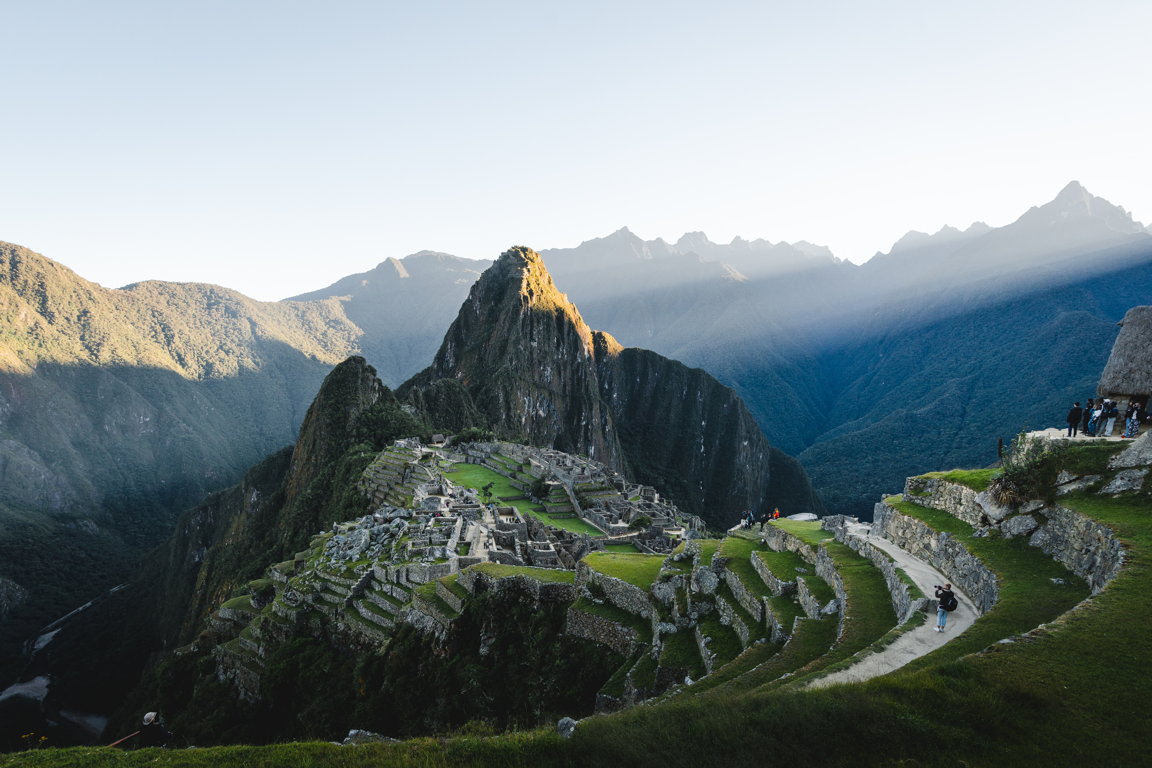






1400 to 1650
Chapter 9
THE AGE OF EXPLORATION AND CONQUEST
the age of exploration and conquest
Strand Three: The History of Europe and the Wider World
@MsDoorley

Slide 2
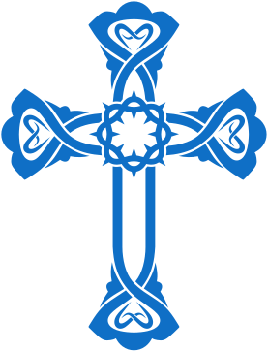
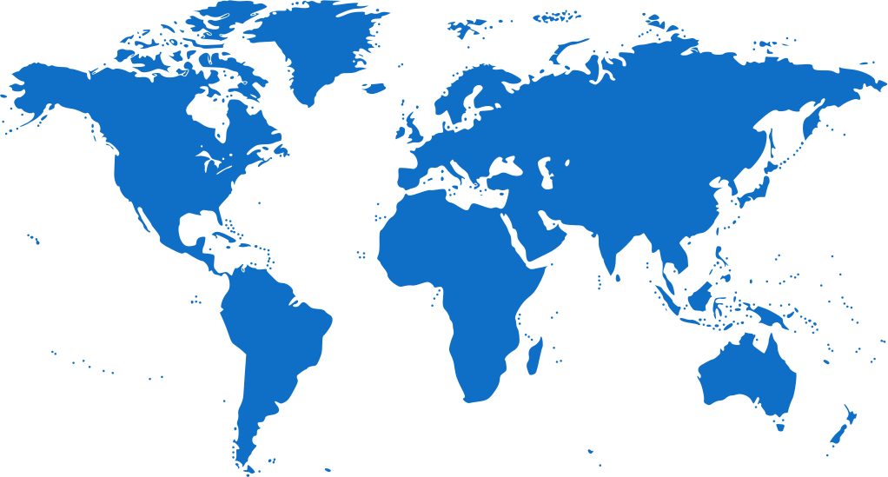
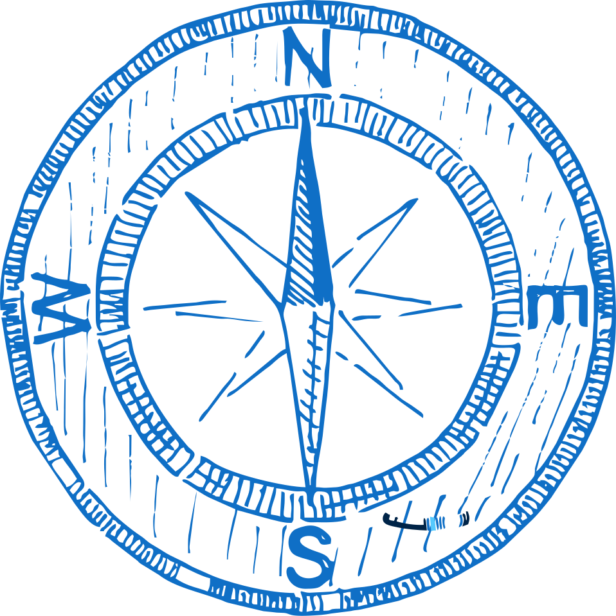
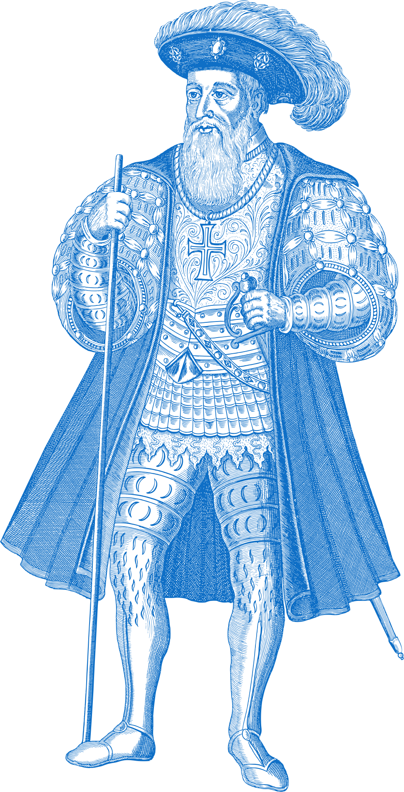
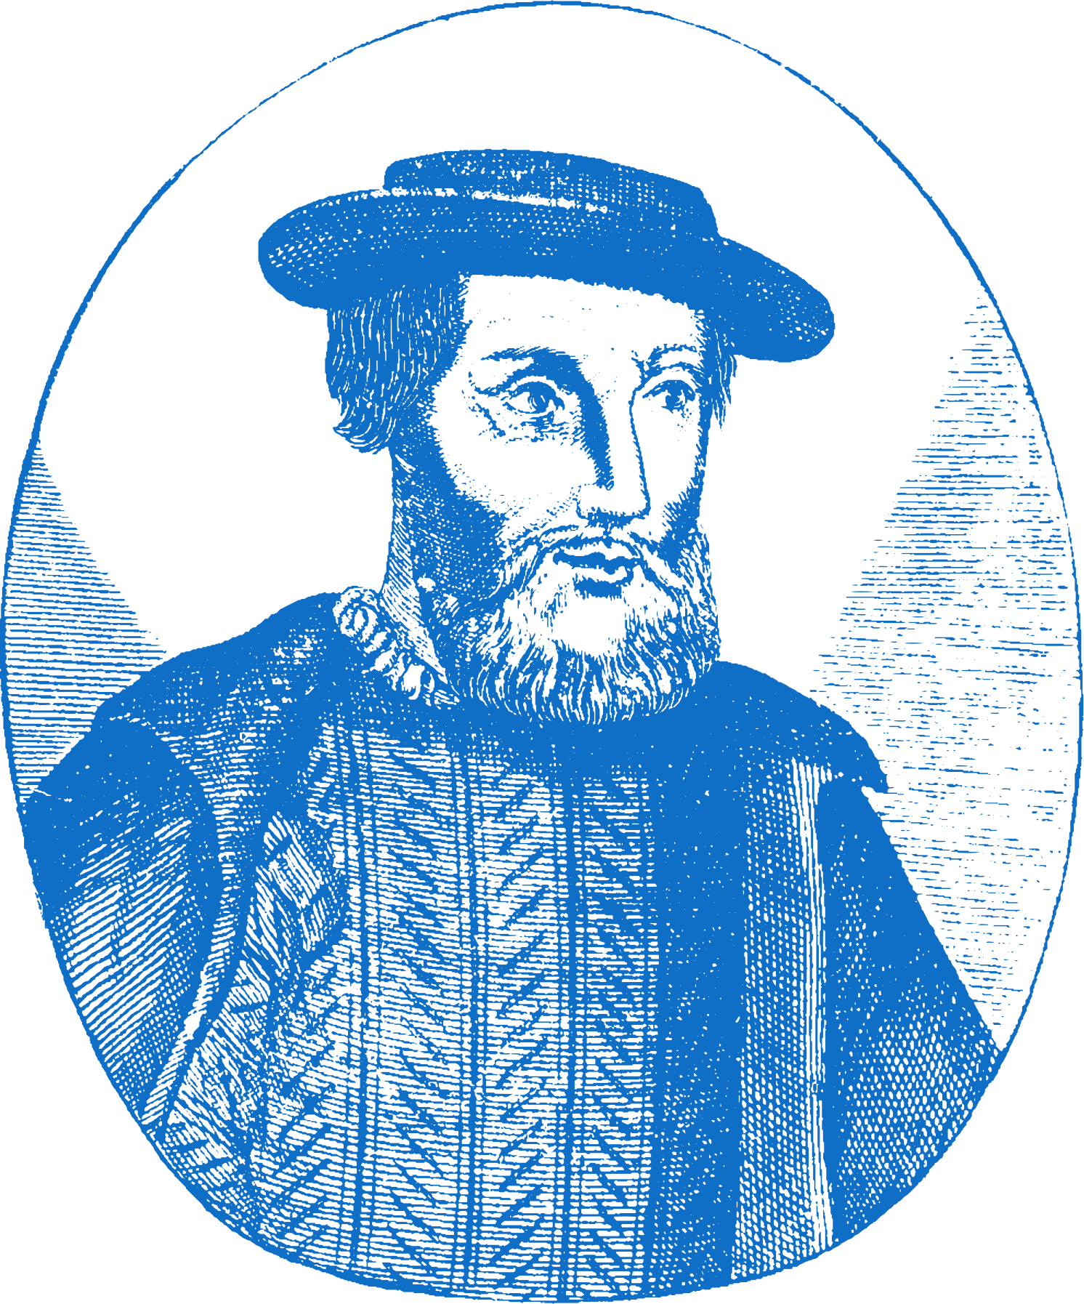
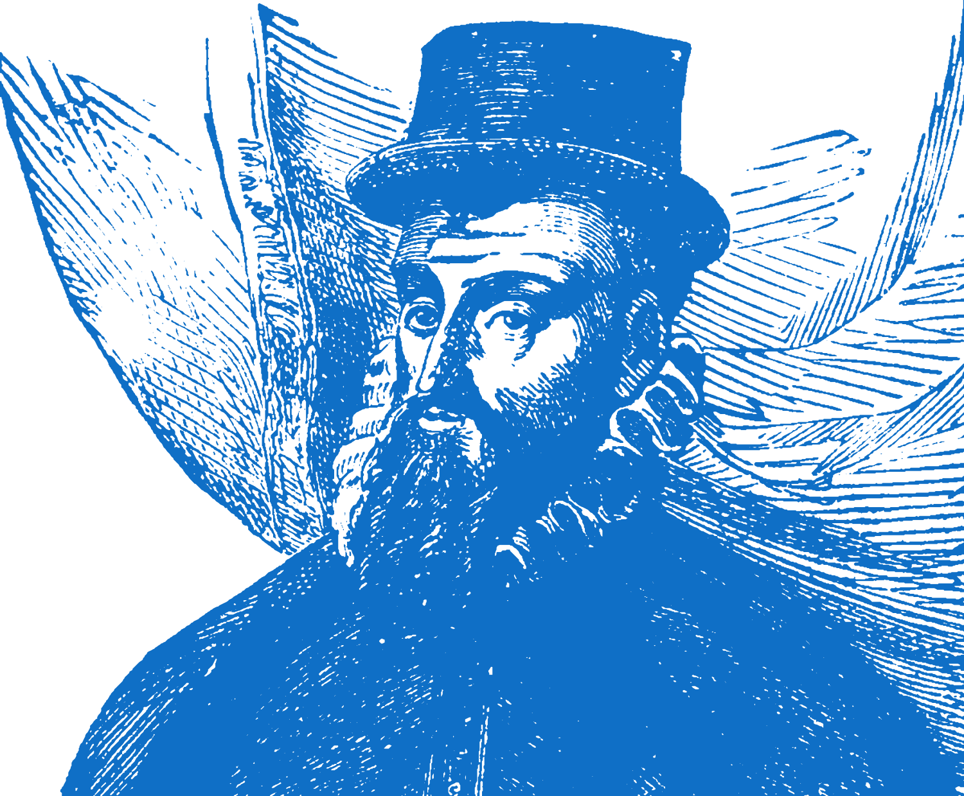
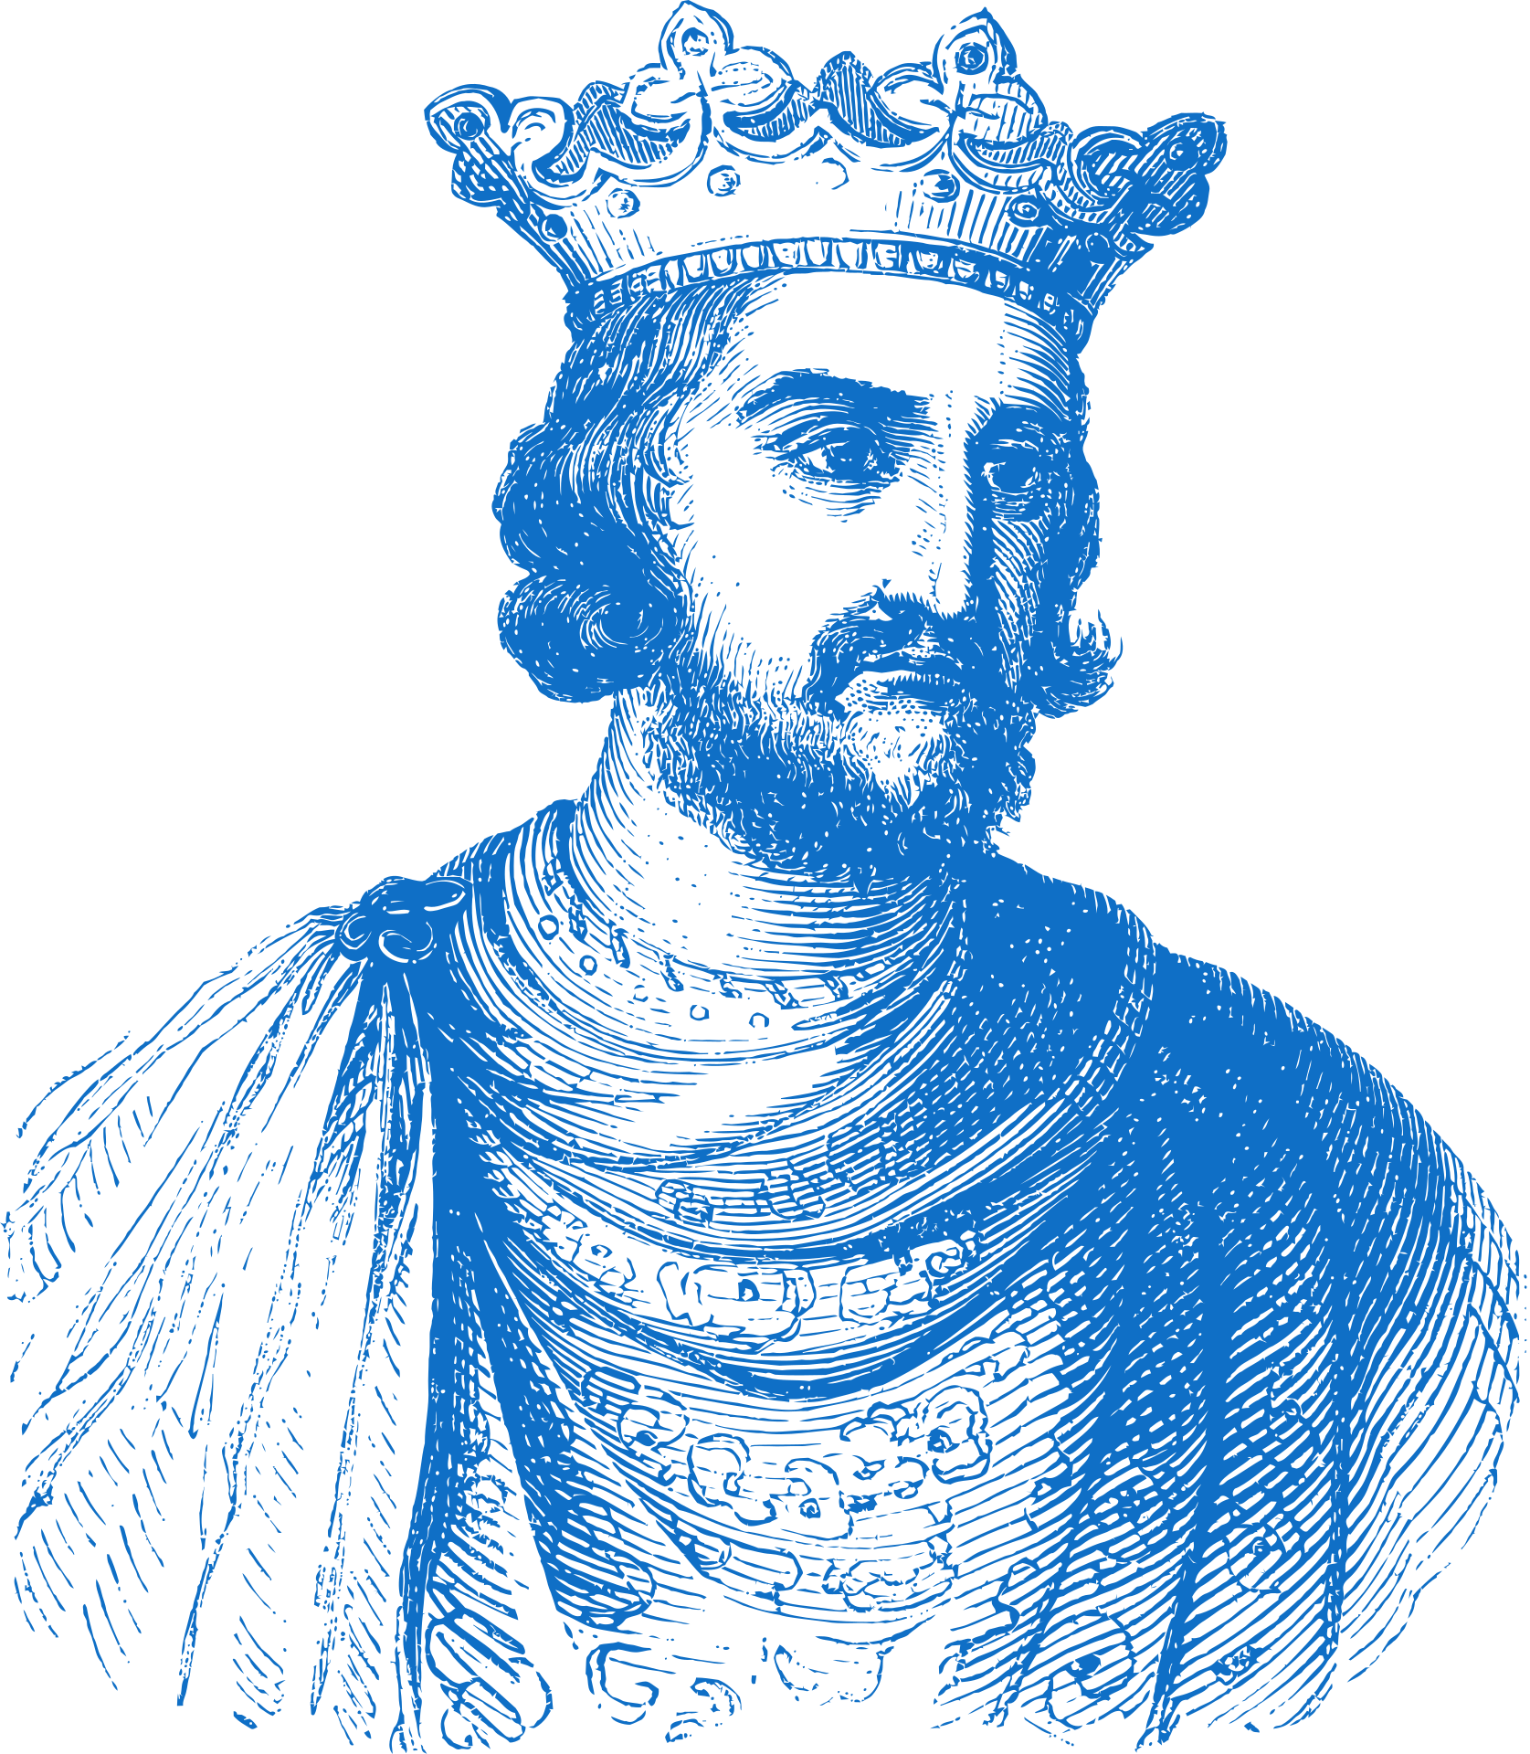
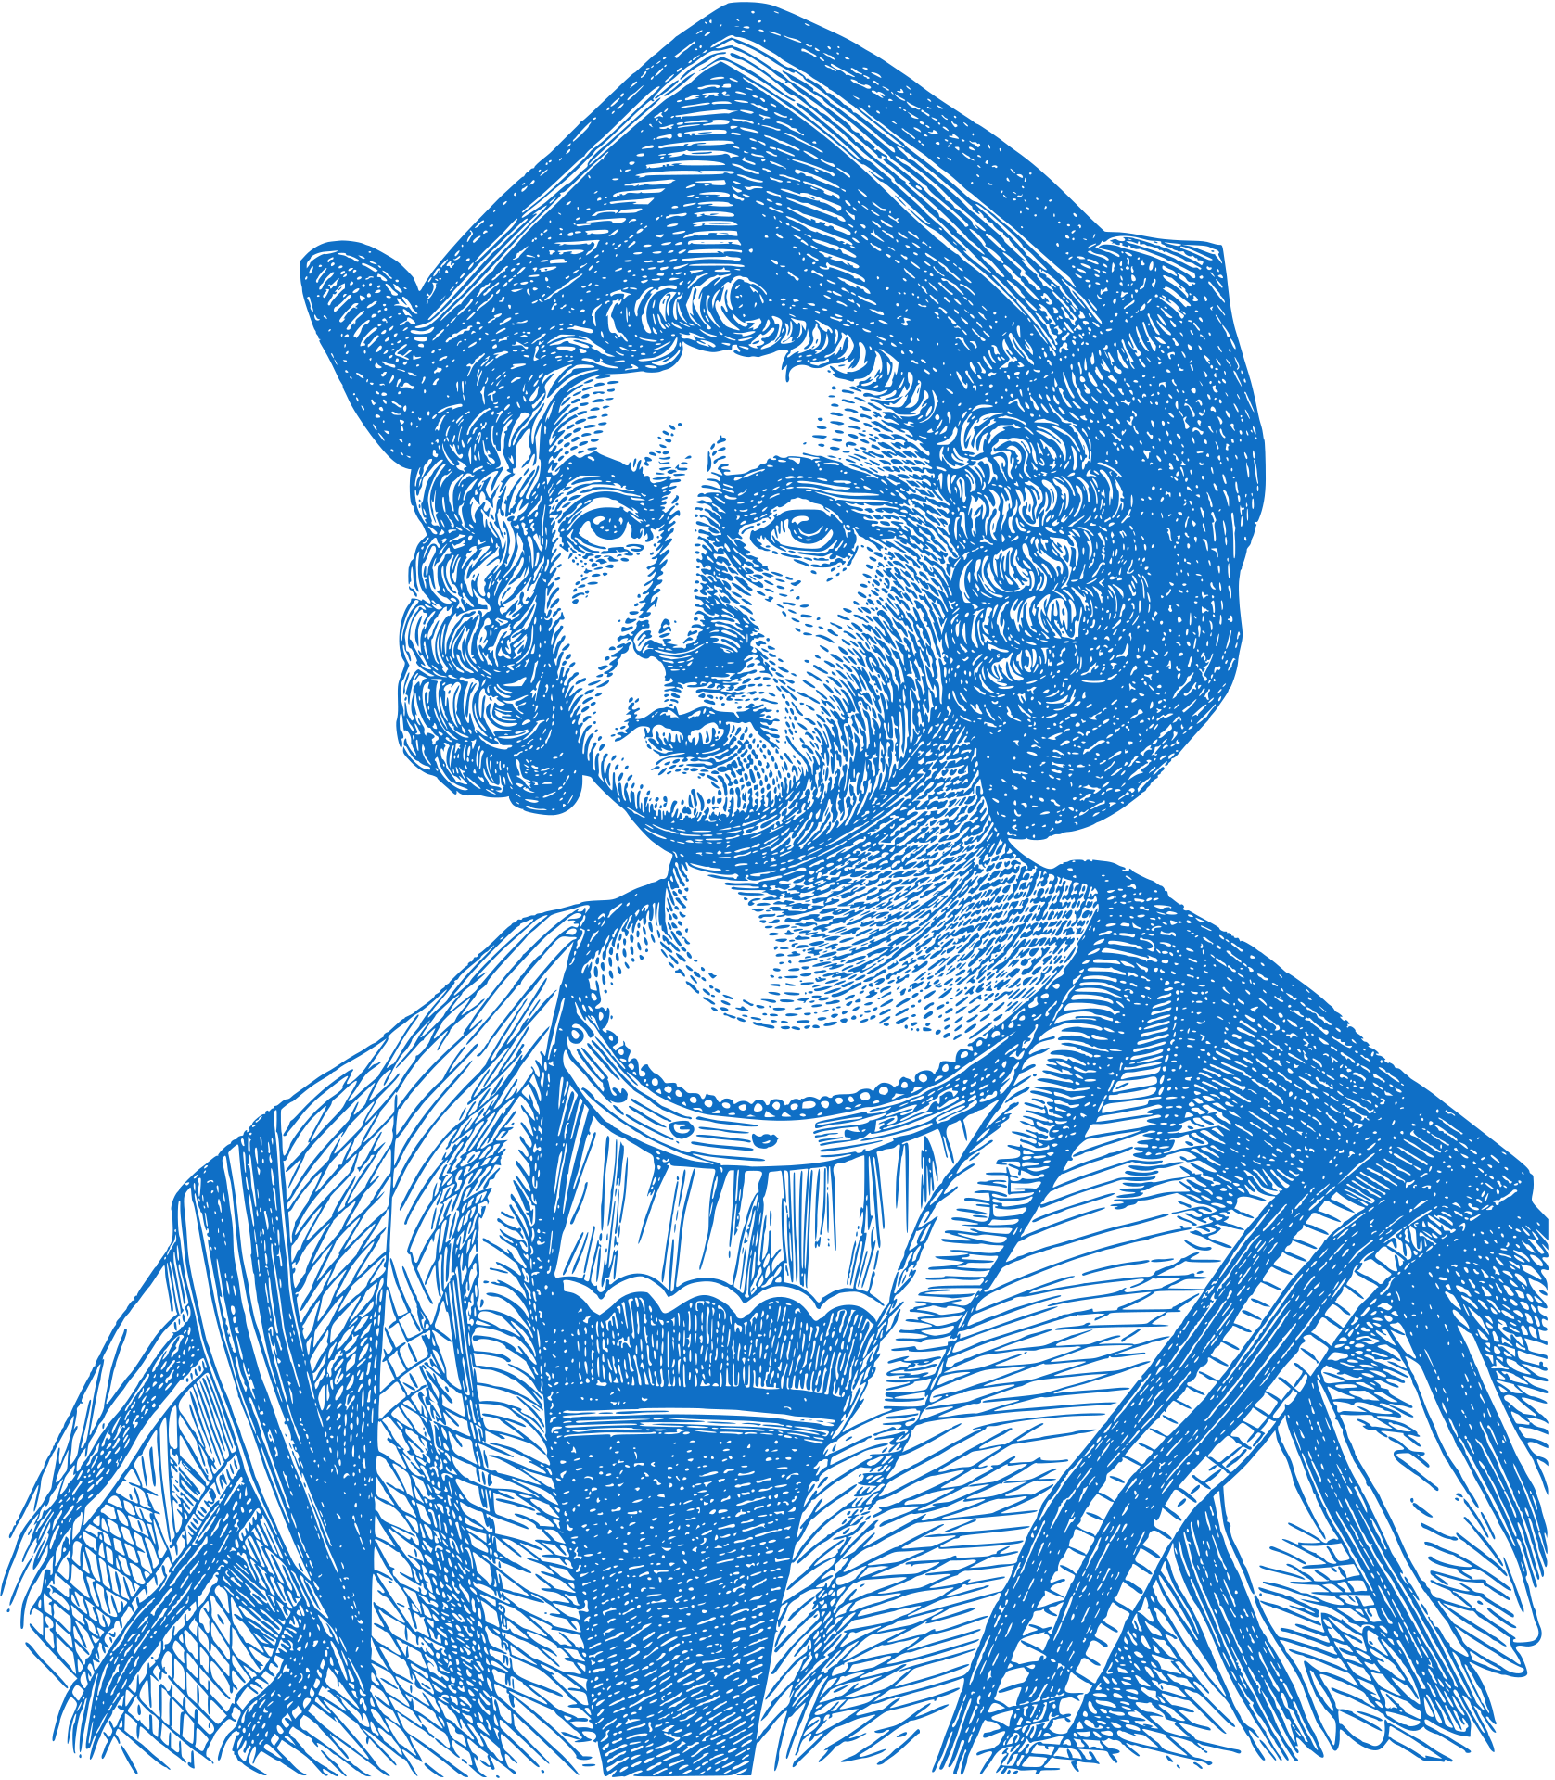
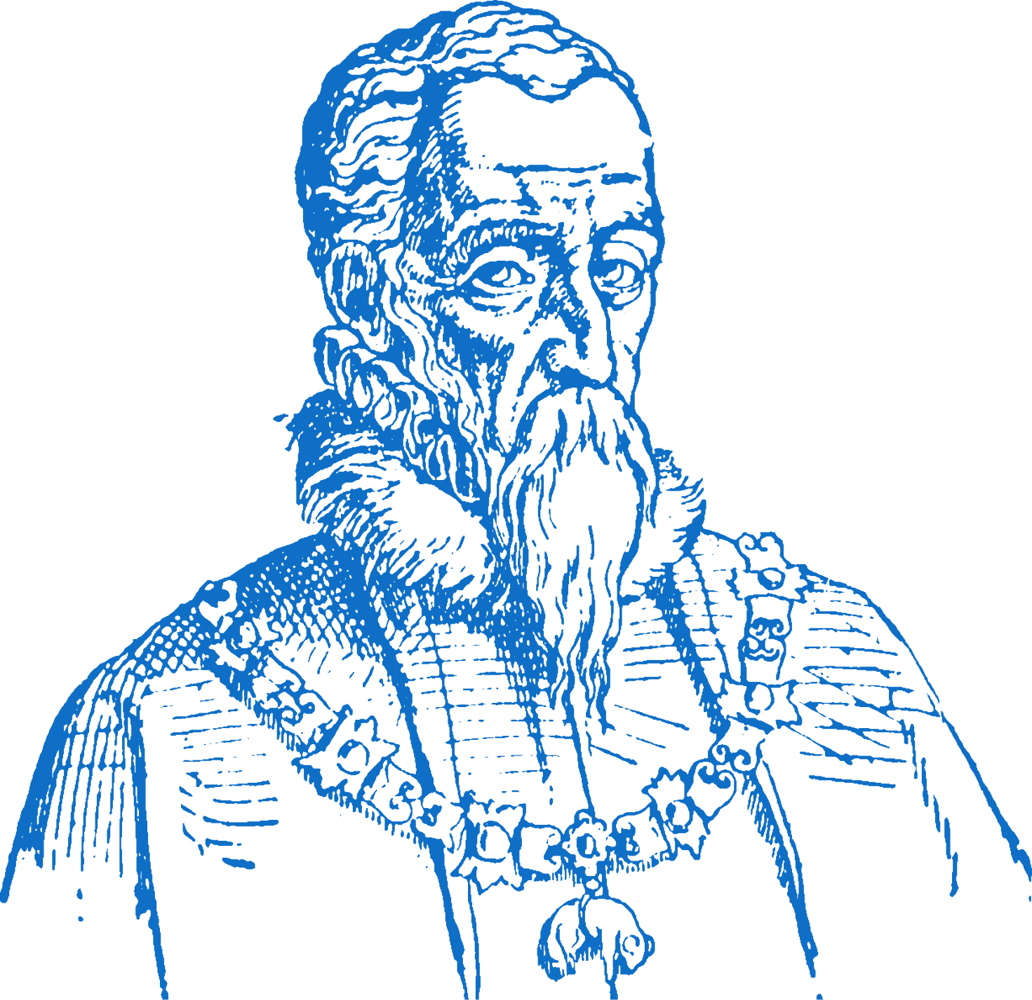
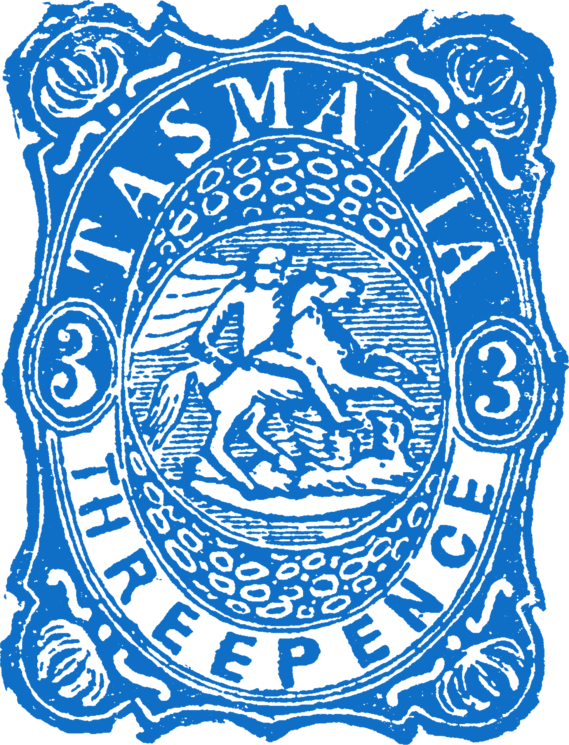
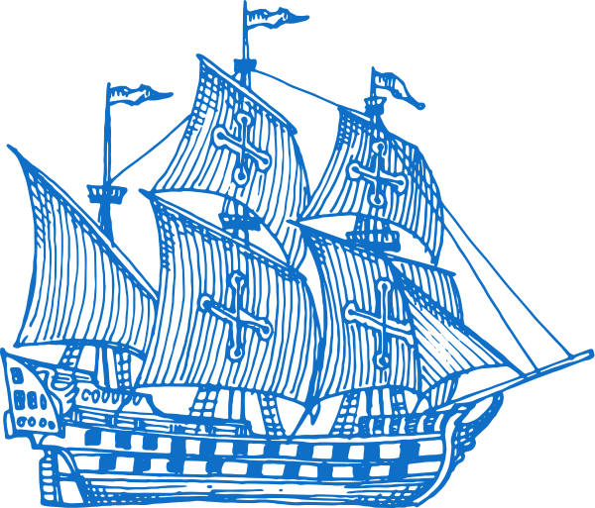
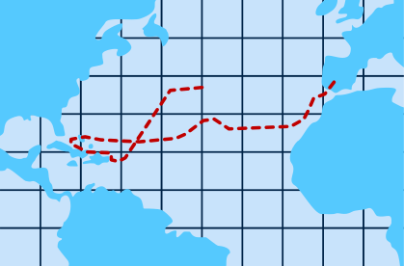
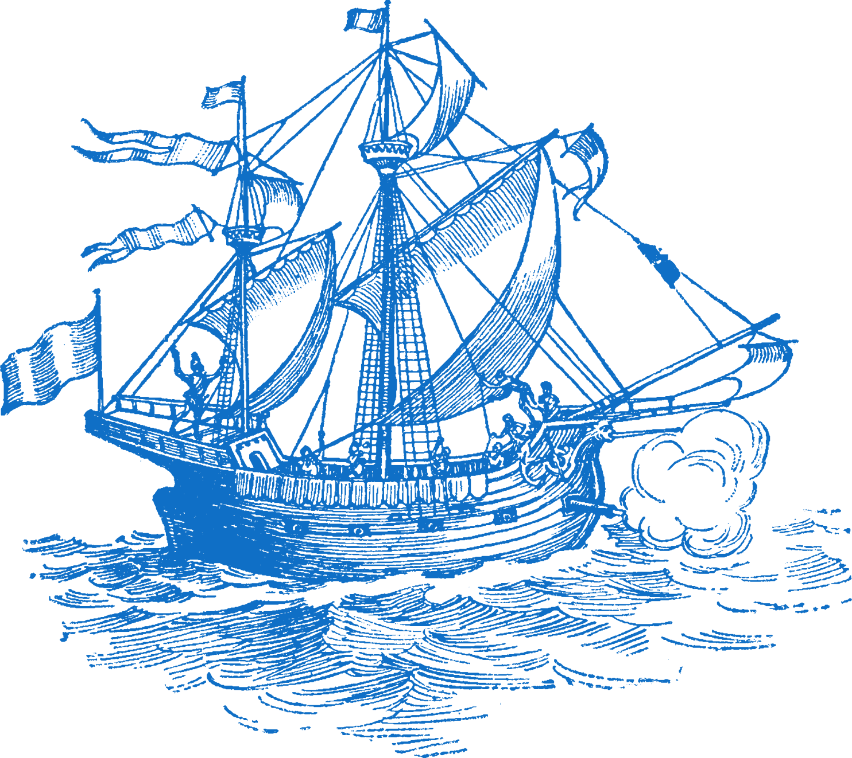
Chapter 9
THE AGE OF EXPLORATION
AND CONQUEST
Bartolomeu Dias becomes first European to sail to the south coast of Africa
Hernan Cortes conquers the Aztec Empire in Mexico.
Francisco Pizarro conquers the Incan Empire in Peru.
1419
1487
1492
1519
1521
1522
1642
Strand Three: The History of Europe and the Wider World
Chapter Nine: The Age of Exploration and Conquest
Prince Henry the Navigator founded his navigation school in Sagres
Christopher Columbus reaches America, claiming the new found land for Spain.
Ferdinand Magellan's voyage becomes the first to circumnavigate the globe.
Abel Tasman was the first European to find Tasmania, south of Australia, and New Zealand.

Slide 3





Learning Outcomes
3.2 EVALUATE the impact of conquest and colonisation on people, with particular reference to Portuguese and Spanish exploration.
3.11 EXPLORE the contribution of technological developments and innovation to historical change.
1.2 CONSIDER contentious or controversial issues in history from more than one perspective and discuss the historical roots of a contentious or controversial issue or theme in the contemporary world
1.7 DEVELOP historical judgements based on evidence about personalities, issues and events in the past, showing awareness of historical significance.
Strand Three: The History of Europe and the Wider World
Chapter Nine: The Age of Exploration and Conquest
@MsDoorley

Slide 4
Introduction
In the fifteenth and sixteenth centuries, many European countries began to explore the wider world by sea, for various reasons. New technology made long voyages possible for the first time. Thus began a period of several hundred years when Europeans first explored, then took over, much of the rest of the world.
In this chapter, we will focus on South America – how civilisations there were conquered and how this had a lasting impact on both sides of the Atlantic.
Strand Three: The History of Europe and the Wider World
Chapter Nine: The Age of Exploration and Conquest
@MsDoorley

Slide 5
1400 to 1650
Chapter 9
9.1: THE REASONS FOR EUROPEAN EXPLORATION
9.1: the reasons for european exploration
Strand Three: The History of Europe and the Wider World
@MsDoorley

Slide 6
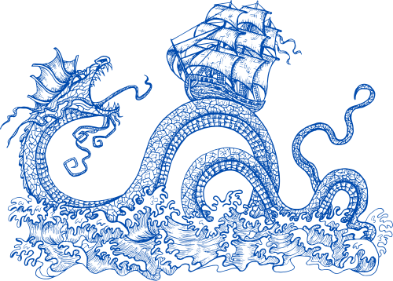
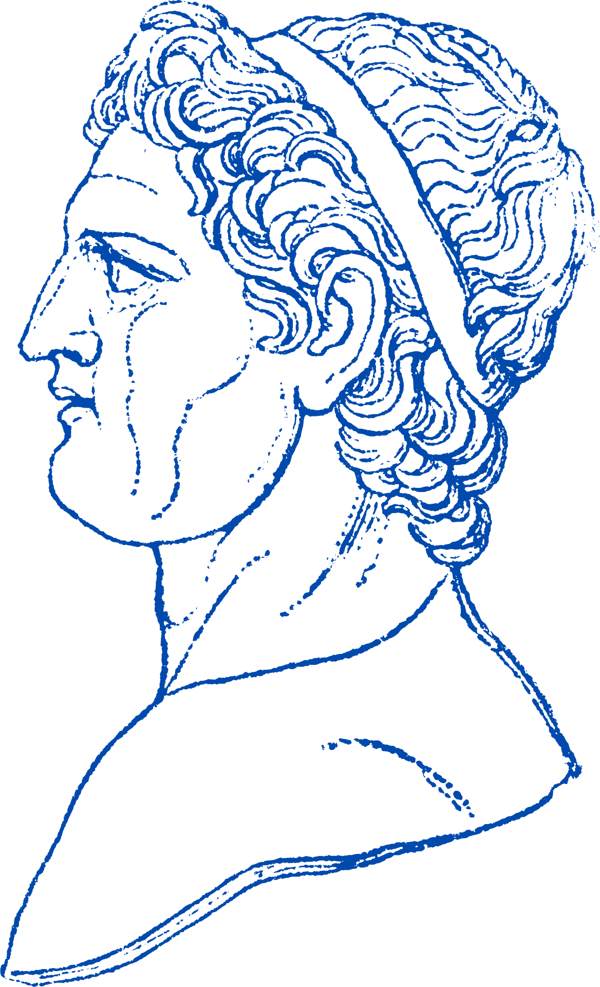
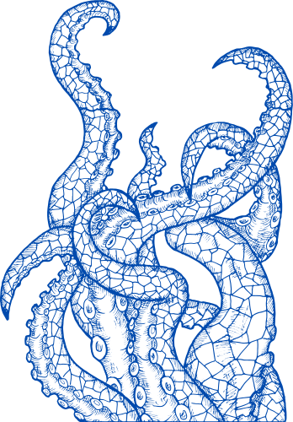
Problems of sea travel
Travel by sea was limited and difficult in the early 1400s.
  Ships could not navigate accurately, often ending up further from where they had planned to go.
  Many sailors were afraid of the unknown. In the early 1400s, it was believed that the Earth was flat and that if they sailed too far they would end up falling over the edge. Others believed the earth was full of monsters.
Strand Three: The History of Europe and the Wider World
Chapter Nine: The Age of Exploration and Conquest
@MsDoorley

Slide 7
Reasons to Explore
Europeans began to explore the wider world from the mid 1400s onwards for several reasons:
  The influence of the Renaissance: People were eager to learn and questioned previous teachings. The rediscovery of Geographia by the Roman writer Ptolemy changed how people understood the world.
  The stories of Marco Polo: Polo was a fourteenth-century Italian who had travelled to China. He brought back many ideas and wonders that people wanted to see for themselves.
  New trade routes: The trade in silks and spices (needed for the preservation and flavouring of food) from the East was very popular. After the Black Death, Europe’s population grew rapidly and wealthier. The Renaissance proved the merchants could become very wealthy if they could get goods into Europe quicker.
  The fall of Constantinople: The Great Silk Road was the main route to get spices and other goods from the East. After Constantinople was conquered by the Turks, this route was cut off from Europe so new routes were needed.
  Desire for empire: Many European rulers sponsored voyages of exploration so that they could expand their territory. Western European countries (France, England, Portugal and Spain) wanted to undermine Italy’s power by bypassing the Mediterranean trade route.
  Spreading Christianity: The Pope encouraged Christian rulers to defeat Muslims who had gained control of the Middle East during the Crusades.
Strand Three: The History of Europe and the Wider World
Chapter Nine: The Age of Exploration and Conquest
@MsDoorley

Slide 8
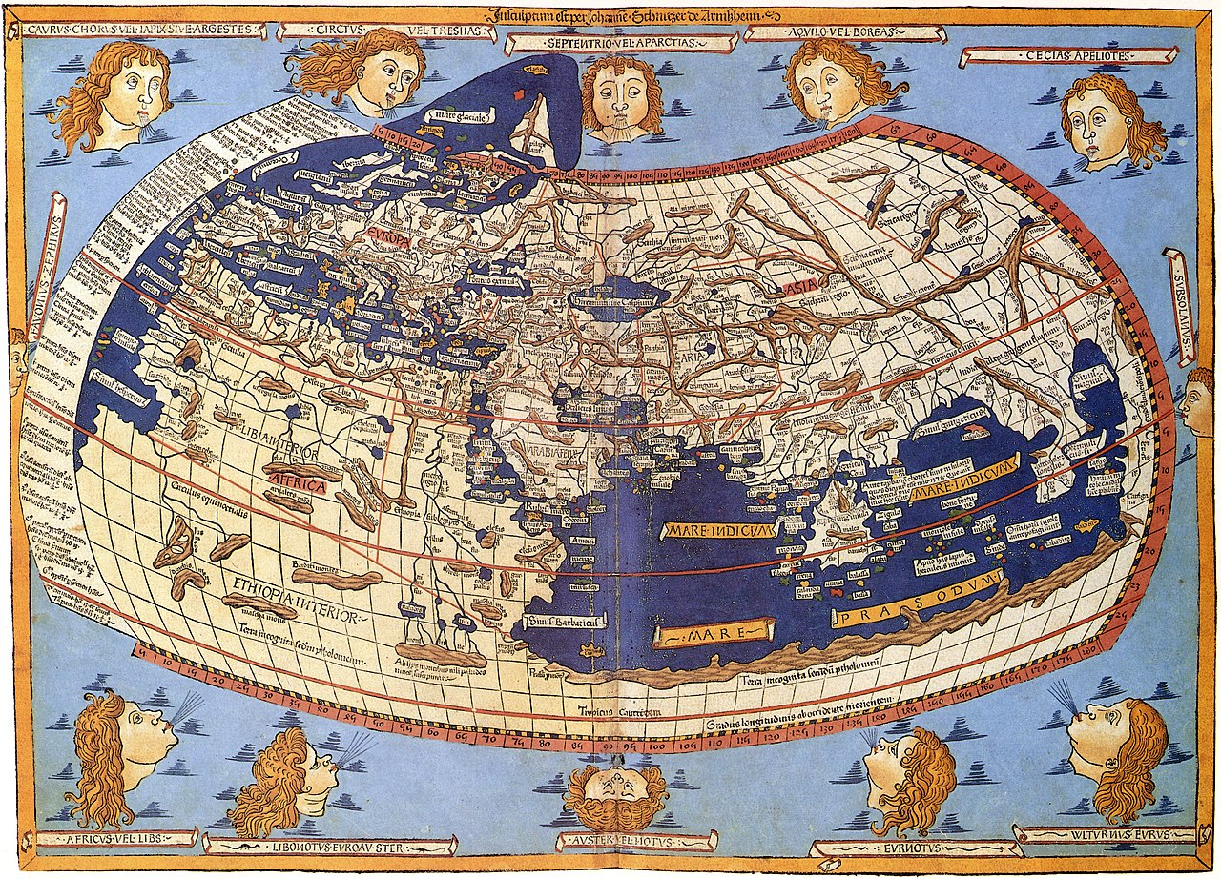
Strand Three: The History of Europe and the Wider World
Chapter Nine: The Age of Exploration and Conquest
Geographia by the Roman writer Ptolemy
@MsDoorley

Slide 9
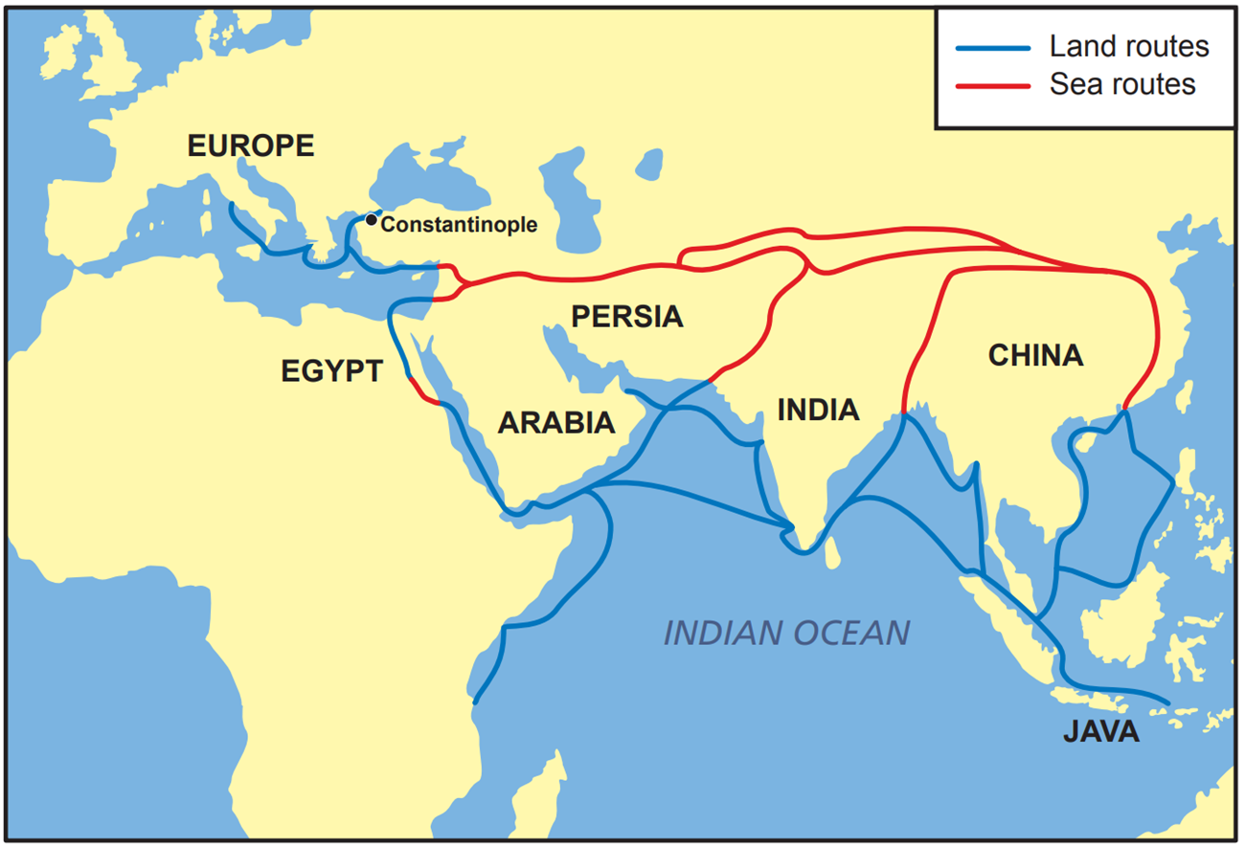
Strand Three: The History of Europe and the Wider World
Chapter Nine: The Age of Exploration and Conquest
Diagram taken from Artefact, 2nd Edition by Eimear Jenkinson and Gregg O'Neill (educate.ie)
@MsDoorley

Slide 10
Checkpoint (pg. 86, Artefact, 2nd Edition)
  What problems did sailors face on long vouages in the 1400s?
  What role did the following factors have in the voyages of discovering: (a) The Renaissance; (b) Trade routes; (c) The desire for empire; (d) Religion?
  Which of the causes of the voyages do you think was most important? Give a reason for your answer.
Strand Three: The History of Europe and the Wider World
Chapter Nine: The Age of Exploration and Conquest
@MsDoorley

Slide 11
Checkpoint (pg. 86, Artefact, 2nd Edition)
  Ships could not navigate accurately, often ending up very far from where they had planned to go; sailors believed the Earth was flat and that they would sail off the edge if they went too far; they feared sea monsters.
  (a) The Renaissance encouraged people to think about the world in different ways; desire to explore and understand the world; influence of Ptolemy’s Geographia; (b) The trade in silks and spices from the East was profitable and explorers could grow rich if they could find ways to get goods to Europe more quickly;(c) European rulers sponsored voyages of exploration so that they could expand their territory to any newly discovered lands; (d) The Pope encouraged Christian rulers to defeat Muslims, who had gained control of the Middle East; explorers aimed to convert the people of any new lands they discovered to Christianity.
  Any reason is valid here once it is properly backed up with an explanation.
Strand Three: The History of Europe and the Wider World
Chapter Nine: The Age of Exploration and Conquest
@MsDoorley

Slide 12
1400 to 1650
Chapter 9
9.2: TECHNOLOGICAL CHANGE: ADVANCES IN NAVIGATION
9.2: technological change: advances in navigation
Before this period, European sailors usually stayed quite close to the coastlines (with exception of the Vikings). For ships to sail straight out into oceans like the Atlantic with hope of safe return voyages, better navigation was needed. Several advances in technology made this possible.
Strand Three: The History of Europe and the Wider World
@MsDoorley

Slide 13
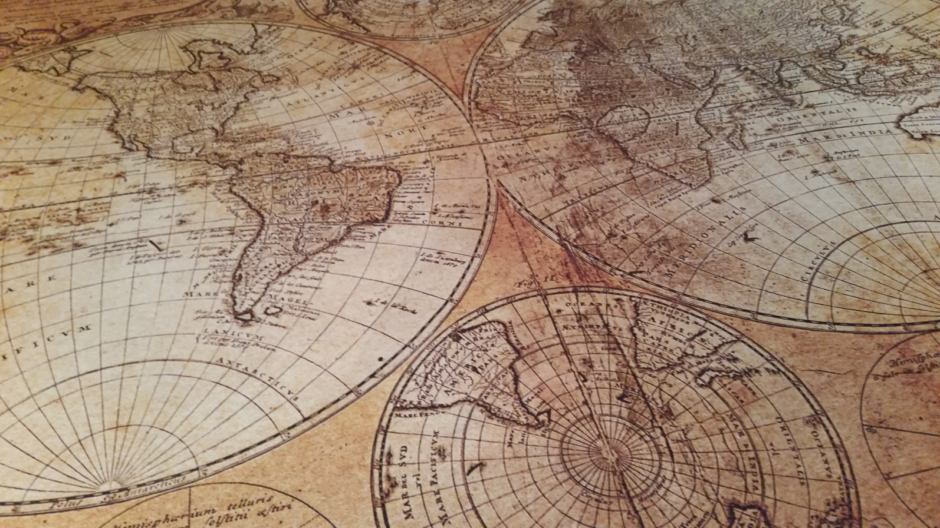
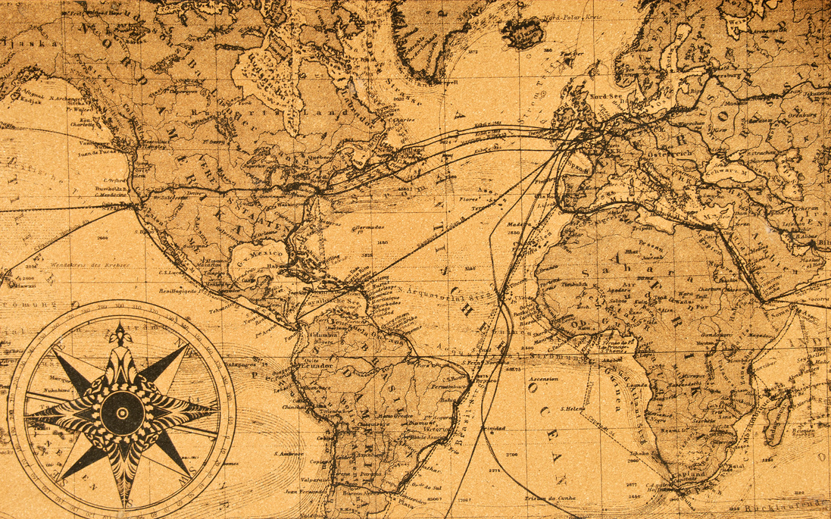
New Maps
To navigate properly, new and more accurate maps were needed. Cartographers (people who draw maps) started using maps from Constantinople (far more advanced than anything that Europe had). The Portuguese developed portolan charts. These charts mapped harbours and coastlines more accurately, while also recording information like currents, tides and depth. As explorers returned from their voyages, they brought more information back with them.
Strand Three: The History of Europe and the Wider World
Chapter Nine: The Age of Exploration and Conquest
@MsDoorley

Slide 14
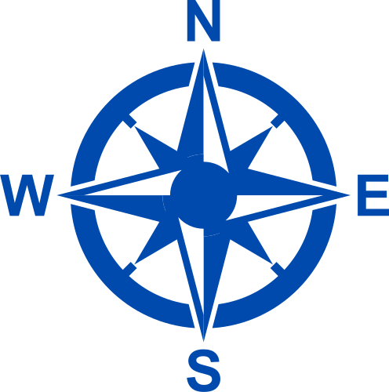
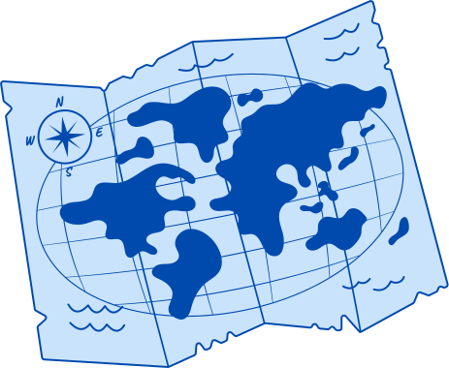
New Equipment
New inventions allowed a ship to calculate its position and speed more accurately.
  A quadrant and an astrolabe helped determine a ship’s latitude (distance from the equator) by using the position of the stars and the sun.
  A compass was used to identify north.
  A log and line was used to measure a ship’s speed in knots.
  A line and lead weight was used to measure the depth of water, especially around a coast.
Strand Three: The History of Europe and the Wider World
Chapter Nine: The Age of Exploration and Conquest
@MsDoorley

Slide 15
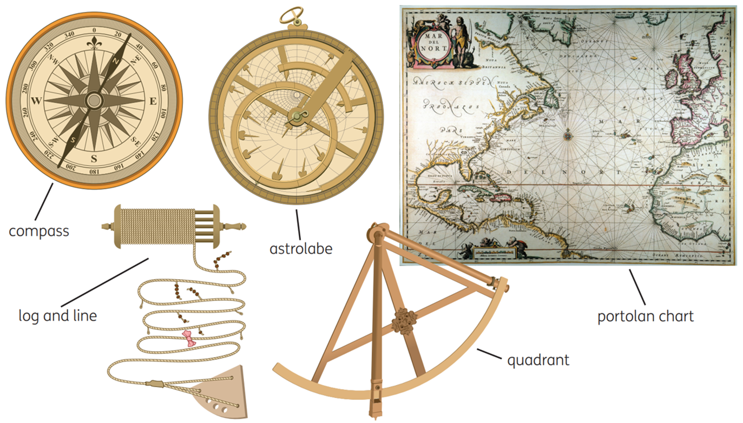
Strand Three: The History of Europe and the Wider World
Chapter Nine: The Age of Exploration and Conquest
Diagram taken from Artefact, 2nd Edition by Eimear Jenkinson and Gregg O'Neill (educate.ie)
@MsDoorley

Slide 16
New Ships
•The fifteenth century saw a new design of ship; the caravel. This ship was large and sturdy enough to make long voyages and able to said in all winds. The caravel’s features were made up of a combination of the best Atlantic and Mediterranean ships.
  Triangular lateen sails allowed ships to sail into the wind and made them easier to manoeuvre in bays and along the coast.
  Carvel-built hulls with planks fitted edge-to-edge (rather than overlapping panels like the Vikings) were far lighter. Also made the ships bigger for more men and supplies.
  Rudders made the caravel easier to steer
  A castle at the back of the deck provided crew quarters. It also made it easier to look out for attackers and to defend.
The caravel were improved upon: A naos were bigger versions, more suited for Atlantic crossings.
Strand Three: The History of Europe and the Wider World
Chapter Nine: The Age of Exploration and Conquest
@MsDoorley

Slide 17
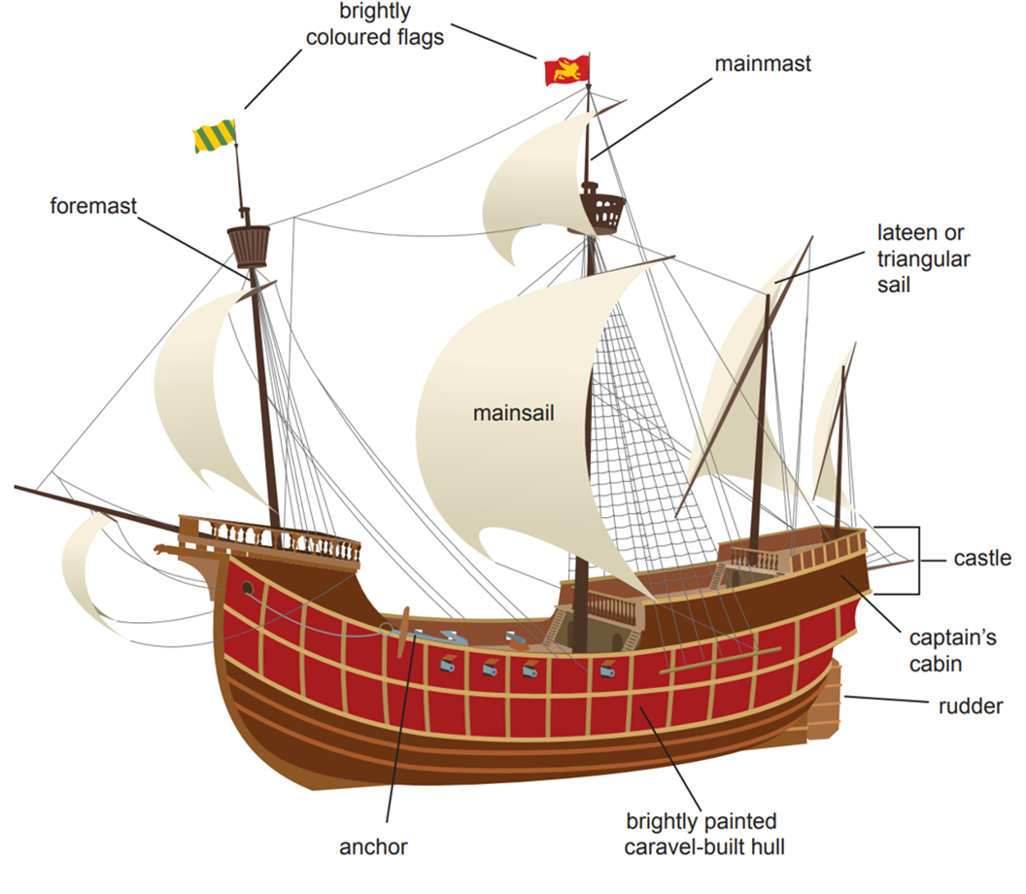
Strand Three: The History of Europe and the Wider World
Chapter Nine: The Age of Exploration and Conquest
Diagram taken from Artefact, 2nd Edition by Eimear Jenkinson and Gregg O'Neill (educate.ie)
@MsDoorley

Slide 18
Life on board the ships
Life on board ships during a voyage of discovery was extremely tough.
  The captain had his own cabin, but most sailors slept on the deck in the open air or else below deck, in hammocks.
  Sailing and maintaining the ship required constant hard work, which included raising and managing the sails, steering and cleaning the ship, making repairs and preparing food for the crew.
  The captain and officers were usually from wealthier social classes, while sailors tended to be poor. This caused tension on ship. Mutiny (sailors rebelling against their captain) was not unusual. Harsh discipline was used to keep order. Men were flogged (whipped) or put in chains for breaking minor rules. Execution was common.
  Food that would last for long voyages tended to be dry and very salty. When the crew ran out fo meat and vegetables, they ate flat hard bread made from water, four and salt called ship's biscuit.
  Ill health was common: the lack of fresh water led to typhoid fever (a bacterial infection) and the lack of foods rich in vitamin C (such as citrus fruit) led to scurvy, which caused exhaustion, tooth loss, vomiting and eventually death.
  Shipwreck was common due to lack of knowledge about sea currents, winds and location of countries.
  Fear of the unknown: “Sea monsters” were believed to be dangerous and many voyagers returned home at the sight of a whale or other “new” creature.
Strand Three: The History of Europe and the Wider World
Chapter Nine: The Age of Exploration and Conquest
@MsDoorley

Slide 19
Checkpoint (pg. 89, Artefact, 2nd Edition)
  What information did a portolan chart give to sailors?
  What instruments were invented to (a) calculate latitude; (b) show direction; (c) measure speed?
  What sort of sails did a caravel have and what were they used for?
  What was a caravel-built hull?
  Describe life on a ship under the following headings: (a) discipline; (b) food; (c) disease.
Strand Three: The History of Europe and the Wider World
Chapter Nine: The Age of Exploration and Conquest
@MsDoorley

Slide 20
Checkpoint (pg. 89, Artefact, 2nd Edition)
  They mapped harbours and coastlines more precisely, recording information like currents, tides and depth.
  (a) Quadrant and astrolabe; (b) Compass; (c) Log and line.
  Large square sails to catch the wind for propulsion (mainsails) and triangular (lateen) sails to sail into the wind and make them easier to manoeuvre in bays and along coasts.
  The hull was built with planks fitted edge to edge, which were far lighter, so ships could be bigger, could have more masts and could carry more men and supplies.
  (a) Harsh discipline was used to keep order. Men were flogged (whipped) or put in chains for breaking minor rules. Execution was common. This was to prevent a mutiny breaking out; (b) Food that would last for long voyages tended to be dry and very salty. When the crew ran out of meat and vegetables, they ate flat, hard bread made from water, flour and salt called ship’s biscuit; (c) The lack of fresh water led to typhoid fever, and the lack of foods rich in vitamin C (such as citrus fruit) led to scurvy, which caused exhaustion, tooth loss, vomiting and eventually death.
Strand Three: The History of Europe and the Wider World
Chapter Nine: The Age of Exploration and Conquest
@MsDoorley

Slide 21
1400 to 1650
Chapter 9
9.3: THE VOYAGES OF EXPLORATION
9.3: the voyages of exploration
Strand Three: The History of Europe and the Wider World
@MsDoorley

Slide 22
The early Portuguese voyages of exploration
The first major voyages of discovery set out from Portugal in the 1400s. Portugal was ideally located on the edge of Europe and close to Africa. It was influenced by Portuguese Kings wanting to outdo their Spanish and Muslim neighbours to the East and South.
Having driven Portugal's Muslims out in the early fifteenth century, the Portuguese attacked Muslim states in North Africa and along the African Atlantic coast. Returning soldiers told stories of fabulously wealthy states further south. In response, Prince Henry the Navigator set up a school of navigation at Sagres, which brought together cartographers, instrument makes, astronomers and experienced sailors together. The Portuguese focused on exploring the African coast to find a way to Asia around Africa.
  Over the following decades they discovered the following where they set up trade and slave bases: Azores, the Canary Islands and the Cape Verde Islands. They also rounded the Gold Coast (modern day Sierra Leone).
  In 1487, Bartolomeu Dias rounded the southern tip of Africa, the Cape of Good Hope.
  1497 saw Vasco da Gama continuing around the coast until he reached Calicut in India – the round trip took two years.
Strand Three: The History of Europe and the Wider World
Chapter Nine: The Age of Exploration and Conquest
@MsDoorley

Slide 23
Results of Portuguese Exploration
Da Gama proved that it was possible to successfully sail around Africa and reach India (and later China). The results included:
  Trade made Portugal wealthy.
  Portugal established a large empire in Africa and Asia (existed up until 1910)
  Portugal gained control of the spice trade by defeating various Arab and Muslim kingdoms
  Increased European spice imports.
  Other European rulers copied Portugal by engaging in voyages of their own.
Strand Three: The History of Europe and the Wider World
Chapter Nine: The Age of Exploration and Conquest
@MsDoorley

Slide 24
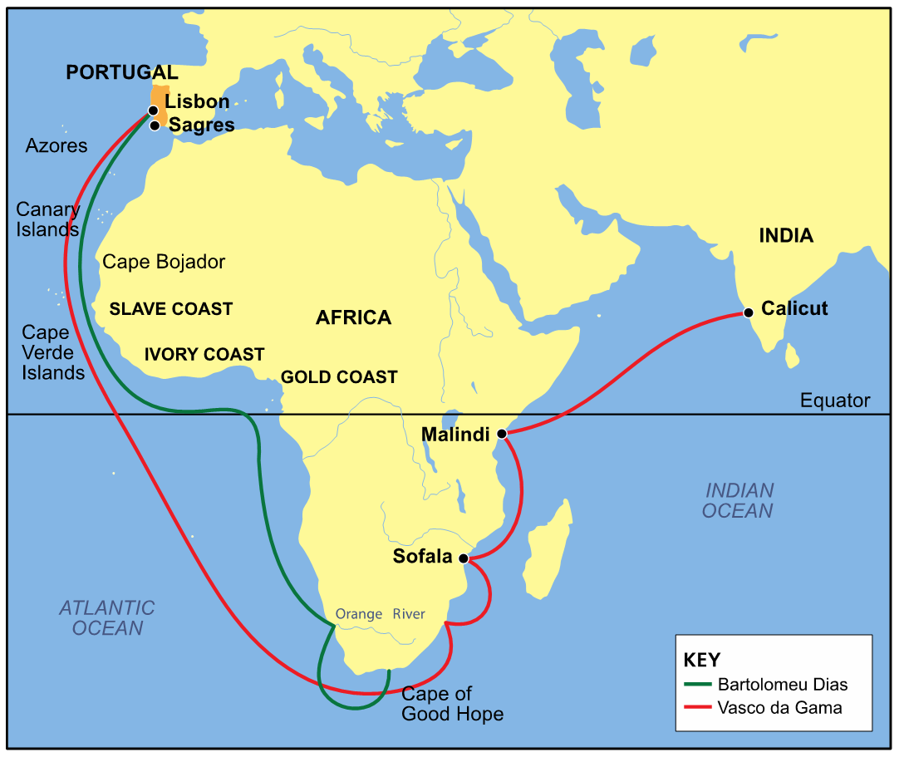
Strand Three: The History of Europe and the Wider World
Chapter Nine: The Age of Exploration and Conquest
Diagram taken from Artefact, 2nd Edition by Eimear Jenkinson and Gregg O'Neill (educate.ie)
@MsDoorley

Slide 25
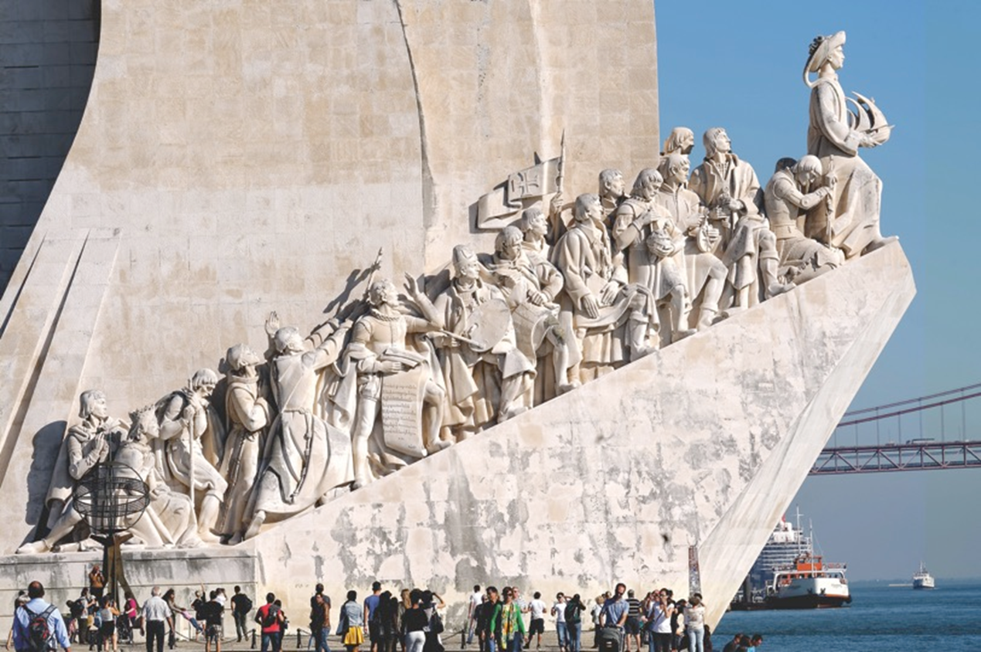
Strand Three: The History of Europe and the Wider World
Chapter Nine: The Age of Exploration and Conquest
Diagram taken from Artefact, 2nd Edition by Eimear Jenkinson and Gregg O'Neill (educate.ie)
@MsDoorley

Slide 26
Checkpoint (pg. 91, Artefact, 2nd Edition)
  Why were the earliest voyages of exploration begun by Portugal?
  What did Prince Henry do to support these voyages?
  What voyages did (a) Bartolomeu Dias and (b) Vasco da Gama undertake?
  What were the results of the Portuguese voyages of exploration?
Strand Three: The History of Europe and the Wider World
Chapter Nine: The Age of Exploration and Conquest
@MsDoorley

Slide 27
Checkpoint (pg. 91, Artefact, 2nd Edition)
  Portugal was ideally located on the edge of Europe and close to Africa. Its king wanted to find new trade routes that could make Portugal rich enough to protect itself from its more powerful neighbours, especially Spain.
  He founded the school of navigation at Sagres to bring together cartographers, instrument-makers, astronomers and experienced sailors to advance knowledge and to perfect naval technology.
  (a) Dias sailed around the southern tip of Africa (the Cape of Good Hope) in 1487; (b) da Gama sailed up the eastern African coast and then east to Calicut in India in 1497.
  They established a large empire in Africa and Asia; controlled the spice trade by defeating Arab and Muslim kingdoms; Portugal became wealthy; other countries sought to follow Portugal’s example.
Strand Three: The History of Europe and the Wider World
Chapter Nine: The Age of Exploration and Conquest
@MsDoorley

Slide 28
The discovery of the 'New World'
Portugal’s neighbours and closest rival Spain had to look west to the Atlantic Ocean for their own opportunities to expand their Empire. The most famous explorer of the Atlantic was Christopher Columbus, who reached the Americas in 1492.
Strand Three: The History of Europe and the Wider World
Chapter Nine: The Age of Exploration and Conquest
@MsDoorley

Slide 29
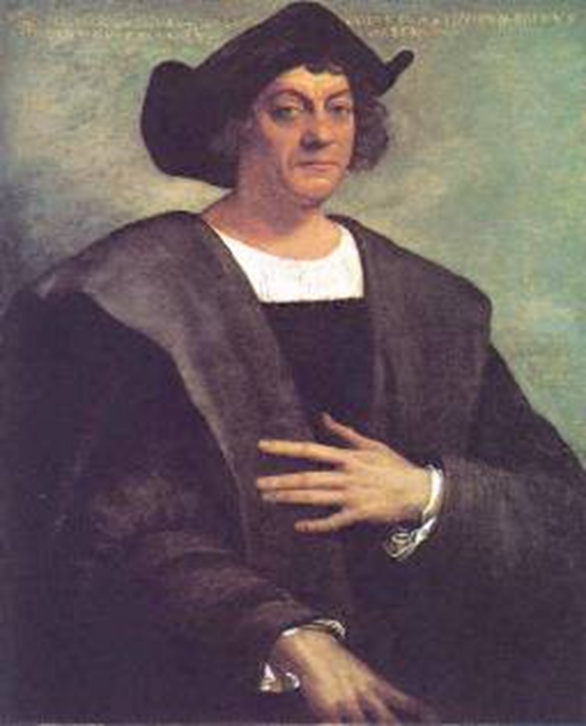
Christopher Columbus, 1451-1506
Christopher Columbus was born in Genoa, Italy in 1451. He was a merchant sailor and studied at Sagres. He was convinced that the best and quickest way to reach China was by sailing west across the Atlantic because of his study of the works of Marco Polo and Ptolemy, and studied a map by Toscanelli. This map led Columbus to believe that Cathay (China) and Cipangu (Japan) were only 4,500km west of Europe. There was just one issue; the map was wrong (by about 10,000km) and there was a very large continent in the way.
After many European rulers rejected his ideas, he convinced King Ferdinand and Queen Isabella of Spain. They gave him two caravels – the Nina and the Pinta – and a naos – the Santa Maria. On 12th October 1492, 69 days after they left Spain, land was sighted. Columbus named it San Salvador and the inhabitants Indians – because he was certain that he had reached India. This is why the Caribbean is still often called ‘the West Indies’. Columbus had not discovered India but rather the American continent – often called ‘The New World’
He was given a hero’s welcome upon his return to Spain in early 1493. He presented Ferdinand and Isabella with some native peoples as slaves, exotic fruits, maize (type of corn), parrots and some gold. They believed that he had found a sea route to Asia and appointed him governor of their new territory. Columbus returned to the New World three more times to continue his search for China.
Columbus mistreated the natives people by selling them into slavery, torturing them and killing them when they would not tell him where the gold and riches were hidden. Columbus died in 1506, a broken man who still insisted that he had found his way to the East.
Strand Three: The History of Europe and the Wider World
Chapter Nine: The Age of Exploration and Conquest
Diagram taken from Artefact, 2nd Edition by Eimear Jenkinson and Gregg O'Neill (educate.ie)
@MsDoorley

Slide 30
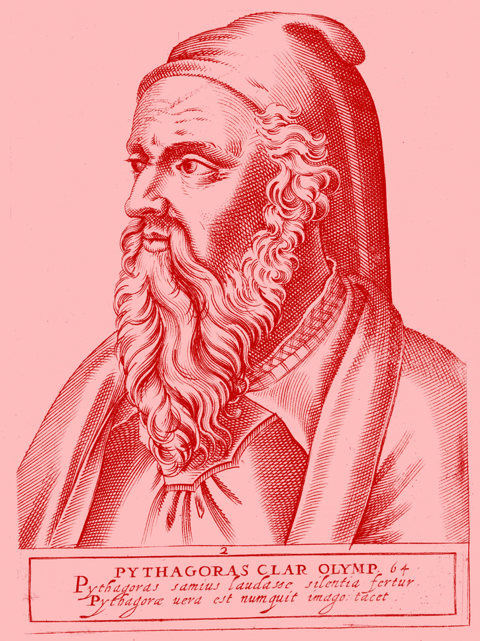
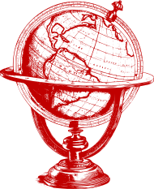
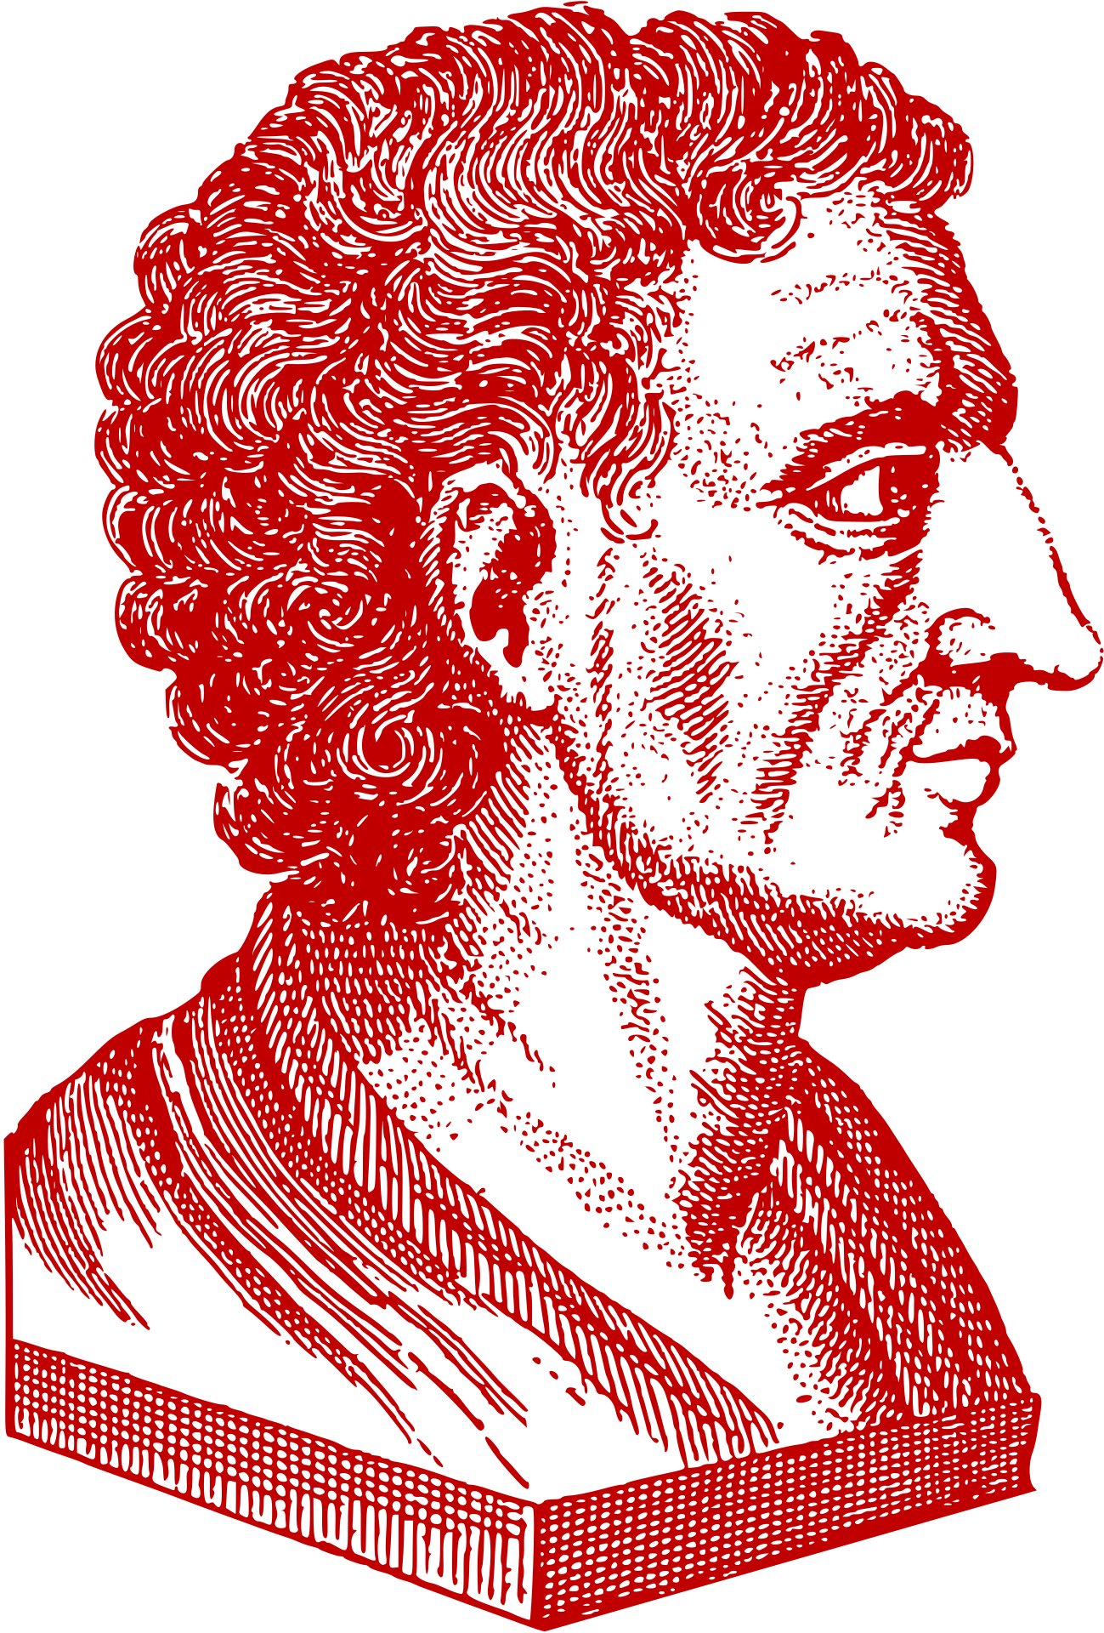
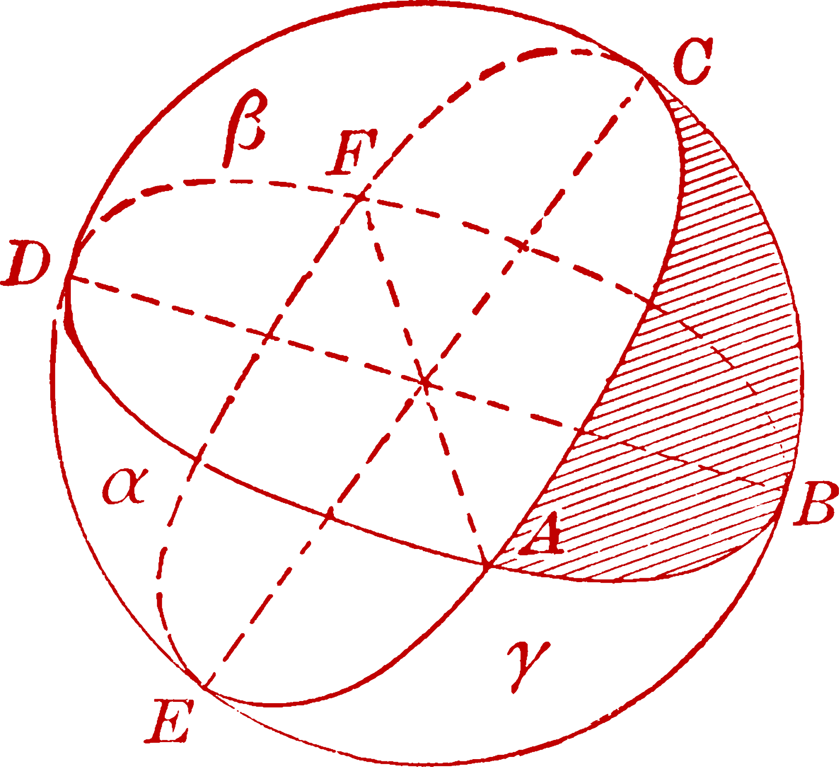





Reinterpreting the Past
Christopher Columbus did not prove that the Earth was round. Nor did most people in the 1400s believe that the Earth was flat. This story was invented by nineteenth-century US historians writing heroic accounts of the man who 'discovered' America. In fact, by the late Middle Ages and early Renaissance, belief in a round world was already widespread. This is due to observations made by scientists, philosophers and mathematicians as early as around 600 BC. Using calculations based on the sun's rise and fall, shadows and other physical properties of the planet, Greek scholars such as Pythagoras and Aristotle had determined that the planet is actually a sphere over 2,000 years before Columbus set sail.
Strand Three: The History of Europe and the Wider World
Chapter Nine: The Age of Exploration and Conquest
Diagram taken from Artefact, 2nd Edition by Eimear Jenkinson and Gregg O'Neill (educate.ie)
@MsDoorley

Slide 31
Early colonisation of the New World
Soon after Columbus' successful voyage, Spanish settlers travelled to the islands of the Caribbean. They were attracted by the promises of riches that Columbus brought back with him. They enslaved the indigenous peoples and forced them to work in mines or on large sugar plantations. As more people came to the New World, it became increasingly clear that Columbus had not reached Asia at all, but an entirely different continent.
The indigenous population of the islands seized by the Spanish numbered at least hundreds of thousands, possibly millions - but by the mid-1490s, they had been practically wiped out. Disease, overwork, disruption of family life and the agricultural cycle rapidly killed a huge proportion of the indigenous population. When this occurred, the Spanish became worried about their source of slave labour and they began to import numbers of slaves from Africa to replace the indigenous population.
Strand Three: The History of Europe and the Wider World
Chapter Nine: The Age of Exploration and Conquest
@MsDoorley

Slide 32
The age of exploration after Columbus
After Columbus had established settlements in the New World, many others followed him.
Explorers continued to explore the rest of the world for over 200 years.
Some of the most important were:
  1497: John Cabot landed in Newfoundland, Canada and claimed it for the English king, Henry VII.
  1519-1522: Ferdinand Magellan led a fleet on a voyage to finally prove that the world was round by circumnavigating (sailing around) the globe.
  1642: Abel Tasman was the first European to find Tasmania, south of Australia, and New Zealand.
Strand Three: The History of Europe and the Wider World
Chapter Nine: The Age of Exploration and Conquest
@MsDoorley

Slide 33
Checkpoint (pg. 91, Artefact, 2nd Edition)
  Why did settlers travel to the New World?
  What effect did they have on the indigenous peoples of the Caribbean?
  Why were African slaves brought to the New World?
Strand Three: The History of Europe and the Wider World
Chapter Nine: The Age of Exploration and Conquest
@MsDoorley

Slide 34
1400 to 1650
Chapter 9
9.4: THE CONQUEST OF THE NEW WORLD
9.4: the conquest of the new world
Strand Three: The History of Europe and the Wider World
@MsDoorley

Slide 35
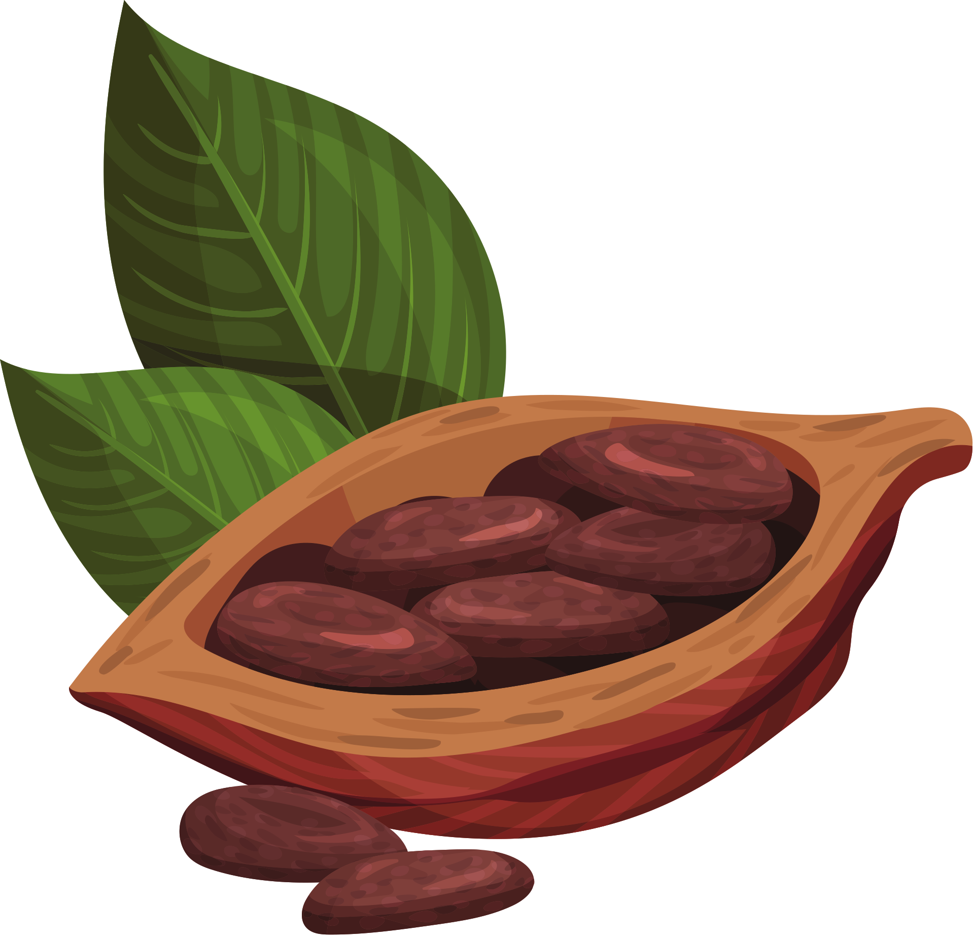
The age of exploration after Columbus
Rumours of the wealth of the New World spread quickly around Europe. Stories of entire cities made of gold, of untold riches that were simply waiting for Europeans to come and take them from the native peoples. These stories prompted men to travel across the sea looking for wealth and adventures. These men were known as conquistadors (Spanish for ‘conqueror’). These men would conquer and eradicate major native American civilisations such as the Aztecs and the Incas.
Strand Three: The History of Europe and the Wider World
Chapter Nine: The Age of Exploration and Conquest
The cacao bean - from which we get chocolate - was sacred to the Aztecs, used only by the elite and in the most important rituals. The drink was very different to ours: bitter, heavily spiced and quite intoxicating! The Spanish brought the beans home, but didn't enjoy the taste: our chocolate is the result of their experiments with milk and sugar. The word 'chocolate' comes from the Aztecs 'xocoatl'.
@MsDoorley

Slide 36
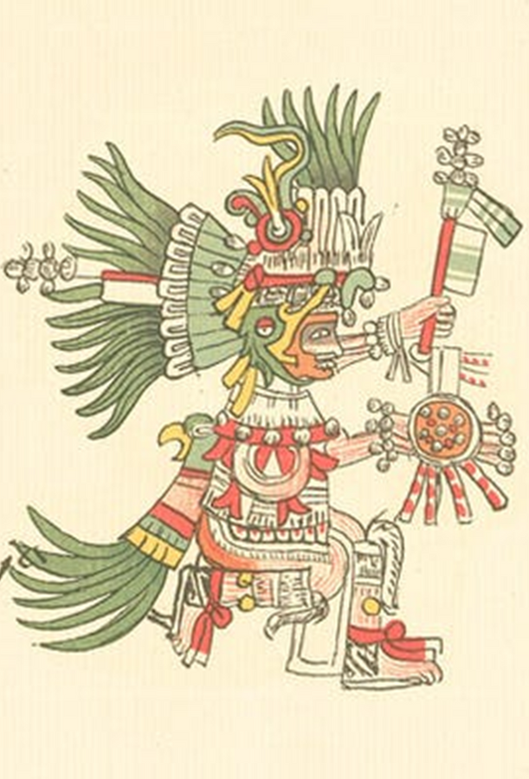
Conquering the Aztecs
The Aztecs came from the south of modern-day Mexico. They conquered rival tribes and by 1420s their empire covered central Mexico. By 1519, there were around 489 cities in the Aztec empire. Its capital, Tenochtitlan (tech-no-titch-lan), was a city of over 250,000 people located on an island in the middle of a lake. Mexico City stands on the same spot today.
The Aztecs had a complex society, with a king and priests at the top, but it was very different from European society or even that in China or Japan. They had no iron or steel, so most weapons were made from wood, stone or copper. Nor were there horses, cattle, sheep, pigs or goats on the continent before the Europeans imported them. For meat, the Aztecs ate turkey, dogs and guinea pigs.
The Aztecs were pagans, meaning they worshipped many gods. The most important was the sun god, Huitzilopochtli (Wit-silo-pocht-li). They believed that if he grew week the sun would not rise and the universe would end. In order to nourish him, they believed that human blood sacrifice was needed.
Strand Three: The History of Europe and the Wider World
Chapter Nine: The Age of Exploration and Conquest
@MsDoorley

Slide 37
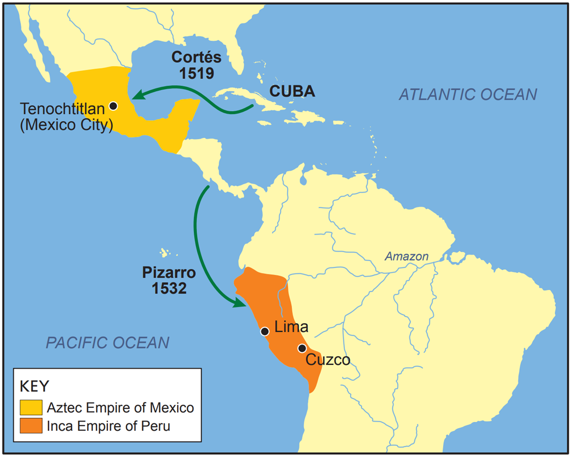
Strand Three: The History of Europe and the Wider World
Chapter Nine: The Age of Exploration and Conquest
Diagram taken from Artefact, 2nd Edition by Eimear Jenkinson and Gregg O'Neill (educate.ie)
@MsDoorley

Slide 38
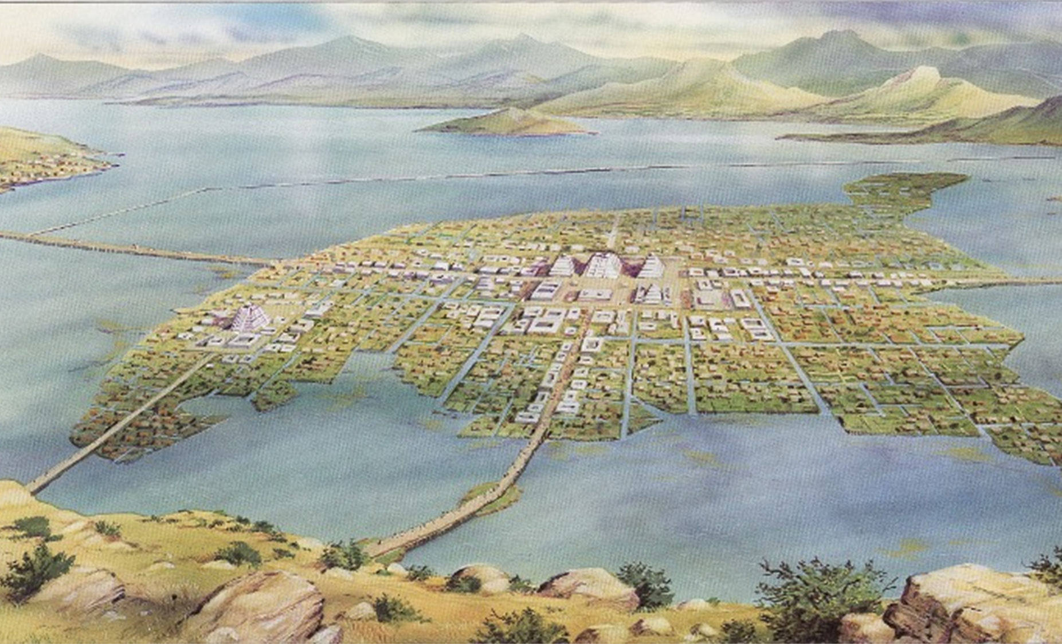
Strand Three: The History of Europe and the Wider World
Chapter Nine: The Age of Exploration and Conquest
Diagram taken from Artefact, 2nd Edition by Eimear Jenkinson and Gregg O'Neill (educate.ie)
@MsDoorley

Slide 39
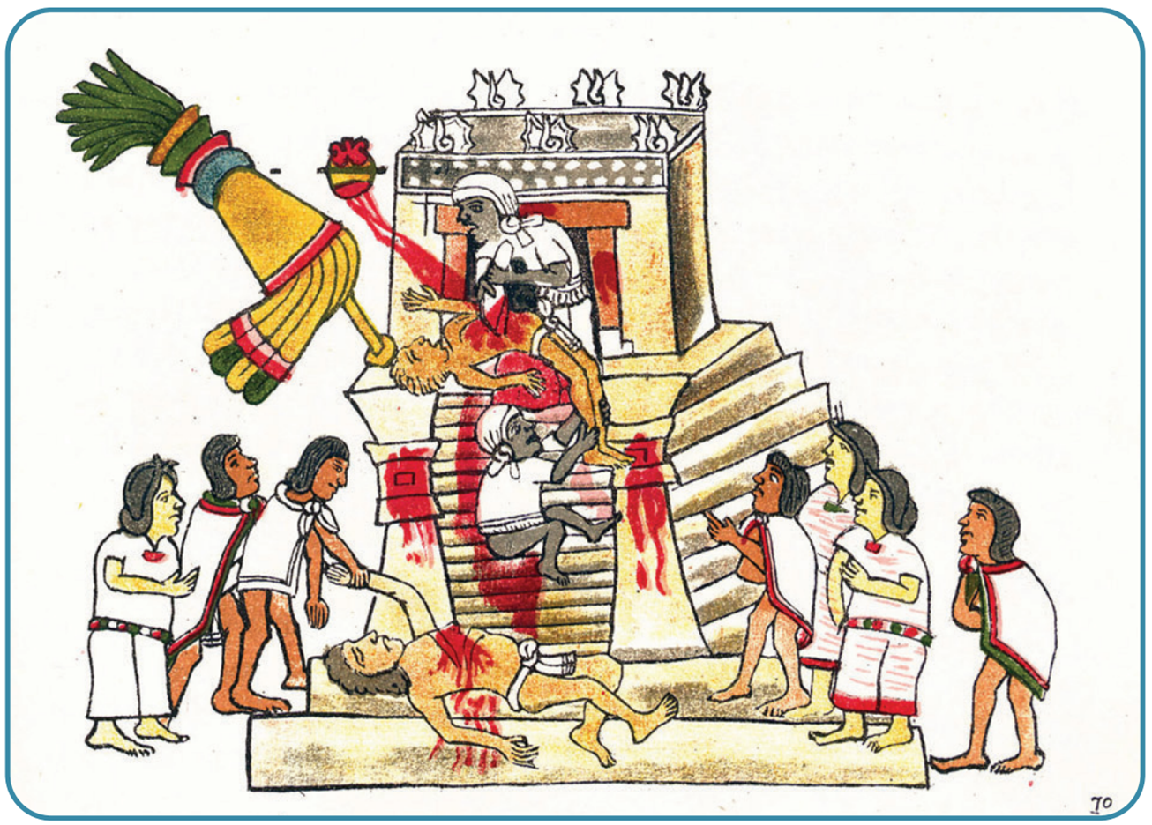
Strand Three: The History of Europe and the Wider World
Chapter Nine: The Age of Exploration and Conquest
Diagram taken from Artefact, 2nd Edition by Eimear Jenkinson and Gregg O'Neill (educate.ie)
@MsDoorley

Slide 40
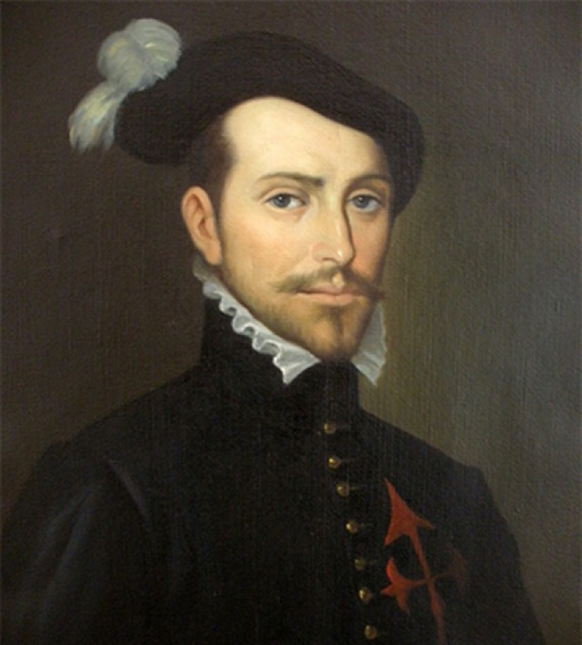
Hernán Cortés, 1485-1547
Hernán Cortés was born in Spain in 1485 and trained as a soldier. He travelled to the New World and gained experience in the conquest of Cuba in 1511. He was ambitious and believed he could earn a fortune in the New World. Inspired by the tales of vast amounts of gold, he decided to attack the Aztecs.
In February 1519, Cortés landed with 11 ships, 500 soldiers and 13 horses. He had the ships burned to show his men there was no going back. He used a local tribe who had been conquered by the Aztecs to help him attack the Aztecs. Cortés was given a slave girl called Malinche who spoke several local languages, quickly learning Spanish to act as his translator. She also bore him a son.
With his men and native troops, Cortés marched to Tenochtitlan, where he was greeted by the Aztec king, Montezuma. The Aztecs believed that one of their gods, Quetzalcoatl, would one day return from over the sea. When Cortés arrived – with his pale skin, and feathered helmet, riding a strange beast – the Aztecs mistook him for his god and worshipped him. However, the Spaniards soon began to steal goal. When there were protests, the Spaniards captured Montezuma and tried to rule through him.
Strand Three: The History of Europe and the Wider World
Chapter Eight: The Renaissance
Diagram taken from Artefact, 2nd Edition by Eimear Jenkinson and Gregg O'Neill (educate.ie)
@MsDoorley

Slide 41
Checkpoint (pg. 95, Artefact, 2nd Edition)
  Give three examples of how Aztec and European society differed.
  Why did Cortés decide to attack the Aztecs?
  Why did he burn his ships upon landing?
  Who did the Aztecs believe Cortés was?
  Why did the Aztecs revolt against the Spaniards?
  How did Tenochtitlan eventually fall?
Strand Three: The History of Europe and the Wider World
Chapter Nine: The Age of Exploration and Conquest
@MsDoorley

Slide 42
Checkpoint (pg. 95, Artefact, 2nd Edition)
1. In Aztec society, there was no iron or steel so they used wood and stone tools and weapons; no horses, cattle, sheep, pigs or goats; many gods; human blood sacrifice.
2. He had heard rumours of their great wealth.
3. To show his men that there was no going back.
4. Their god, Quetzalcoatl, returned from across the sea as promised in their mythology.
5. The Spaniards started to steal from the Aztecs and tried to rule through their king, Montezuma.
6. Cortés laid siege to the city with a massive army and they built a small fleet to cross the lake and attack the island.
Strand Three: The History of Europe and the Wider World
Chapter Nine: The Age of Exploration and Conquest
@MsDoorley

Slide 43
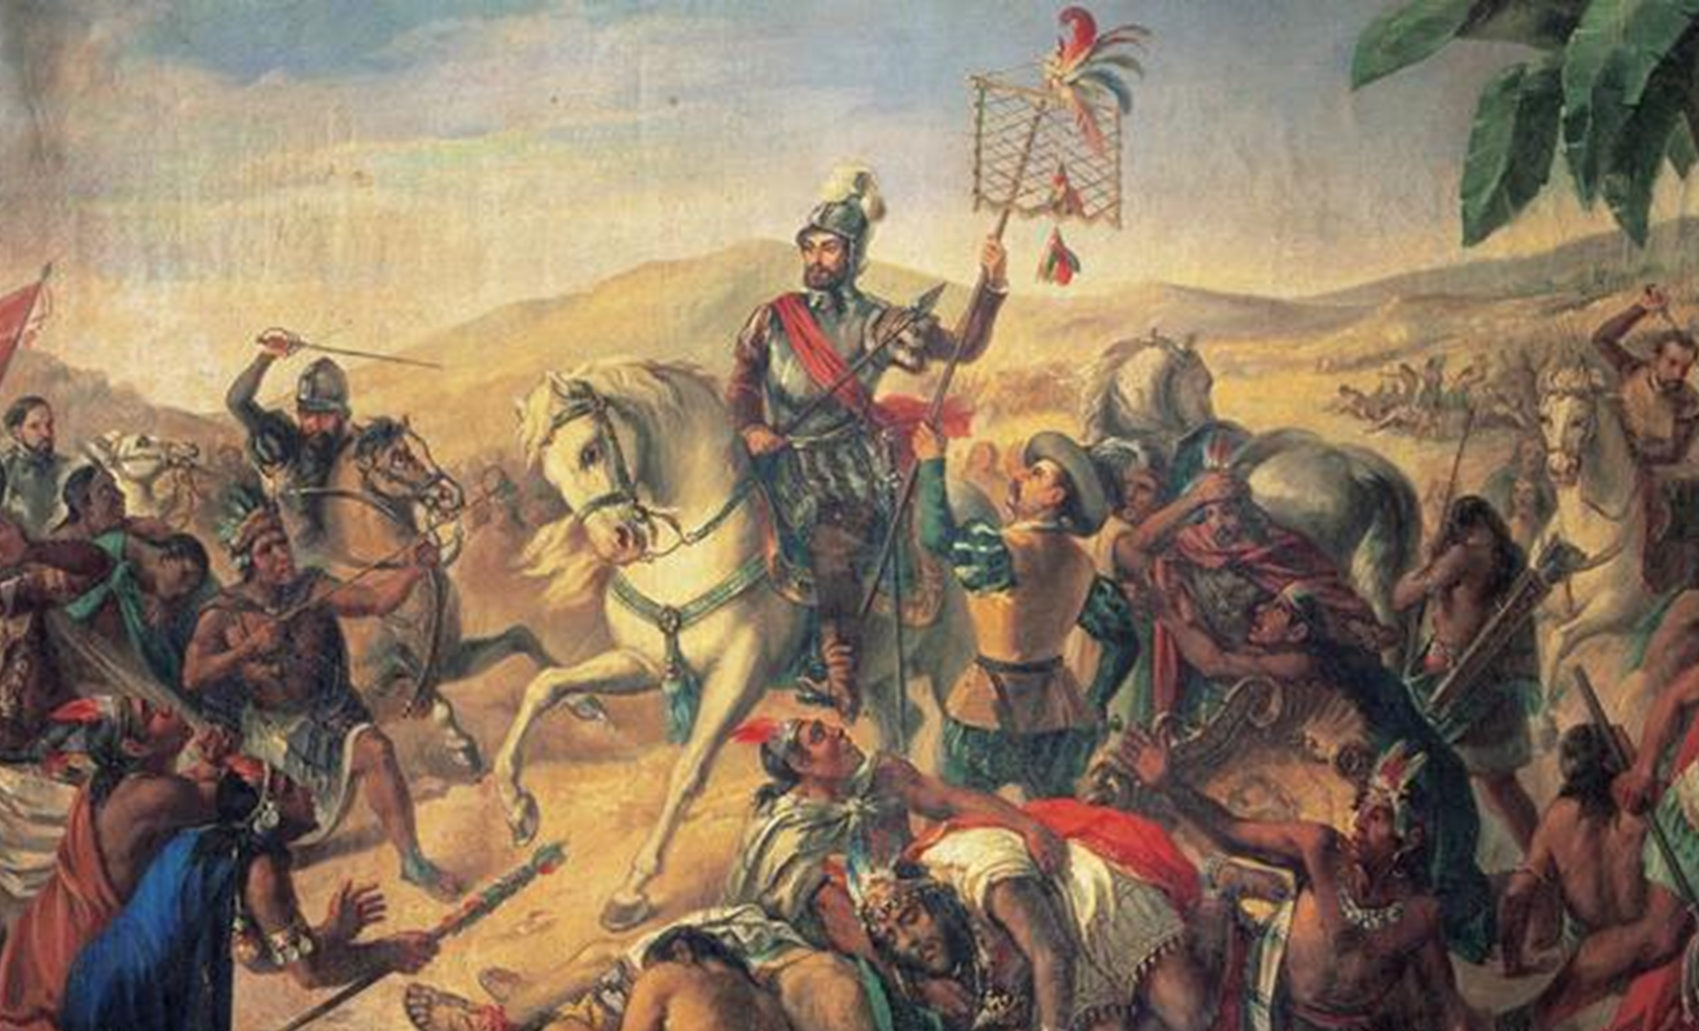
Strand Three: The History of Europe and the Wider World
Chapter Nine: The Age of Exploration and Conquest
Diagram taken from Artefact, 2nd Edition by Eimear Jenkinson and Gregg O'Neill (educate.ie)
@MsDoorley

Slide 44
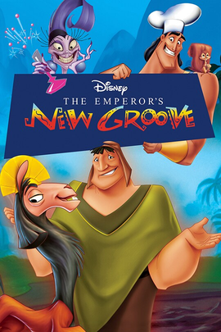
Conquering the Incas
To the south of the Aztecs lay an even more powerful and rich civilisation. The Incas controlled a huge amount of territory in the Andes mountains, along the western coast of South America. The Incan empire was ruled from its capital in Cusco by a god-king.
The Incas were sophisticated engineers and architects and also very fine artists. They used no written script but kept records using a system of knotted string. Roads ran to every corner of their empire and they collected tribute from their subjects.
Strand Three: The History of Europe and the Wider World
Chapter Nine: The Age of Exploration and Conquest
Disney’s Emperor’s New Groove is loosely based on the Incan Empire.
@MsDoorley

Slide 45
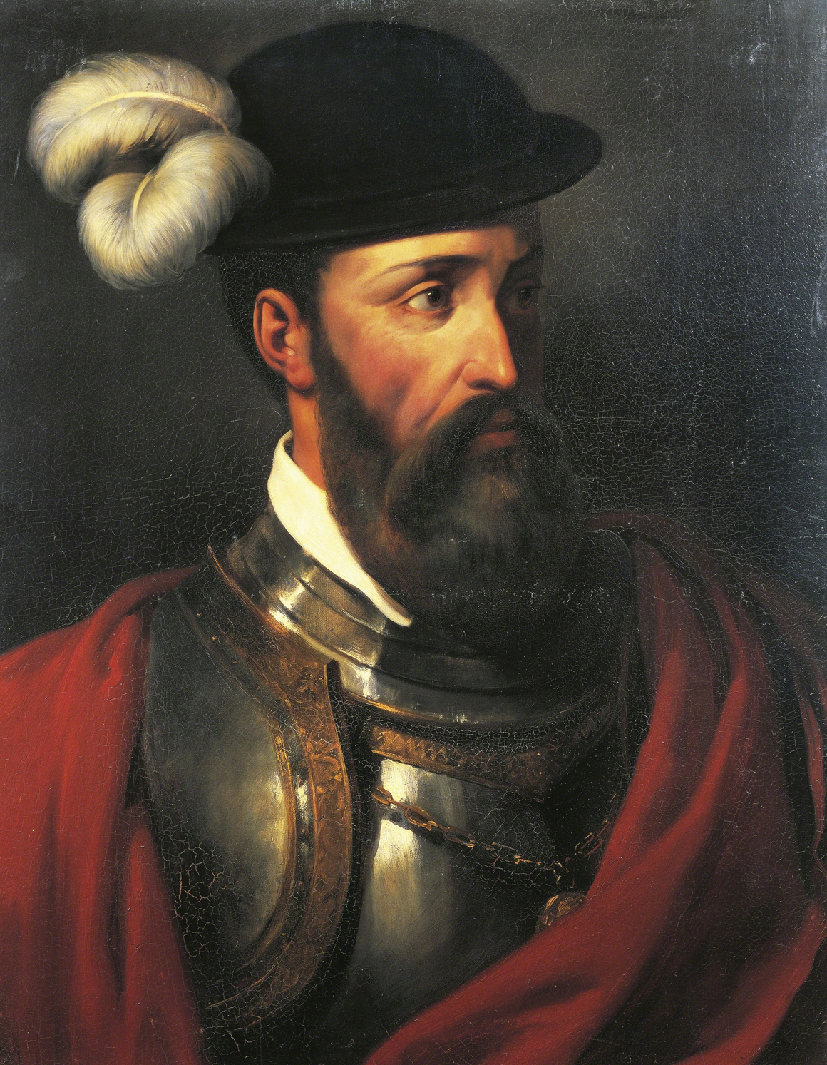
Francisco Pizarro, 1475-1541
Francisco Pizarro was born into poverty in Spain. He received no education and found his way to the New World by serving on a ship. There he found work as a soldier on missions to explore Central America. He gained a reputation for toughness and ruthless behaviour. He heard rumours of the great wealth of the Incas and was granted a commission by King Charles V of Spain in 1528 to conquer them. He gathered a small army of 180 men and 27 horses and invaded the Incan Empire in 1532.
Pizarro met the Incan king, Atahualpa, at the town of Cajamarca. To give him the excuse to attack the Incas, Pizarro had a priest approach Atahualpa with a bible. The king threw it aside, allowing Pizarro to claim that it was an insult to the Christian faith and so Pizarro ordered his men to attack. Although vastly outnumbered by the Incas, the Spanish had superior weapons and easily outpowered their enemies before taking Atahualpa as their prisoner.
The Incas offered to fill a room with gold and silver in return for their king. Pizarro accepted the treasure but had the king executed anyway – this sent the empire into chaos as the king had left no heir. Pizarro defeated the remaining Incan armies at Cusco before declaring their empire the Spanish province of New Castile. He established a new capital city at Lima. Huge deposits of gold and silver were later found in the Andes, making Spain the wealthiest country in Europe.
Strand Three: The History of Europe and the Wider World
Chapter Eight: The Renaissance
Diagram taken from Artefact, 2nd Edition by Eimear Jenkinson and Gregg O'Neill (educate.ie)
@MsDoorley

Slide 46
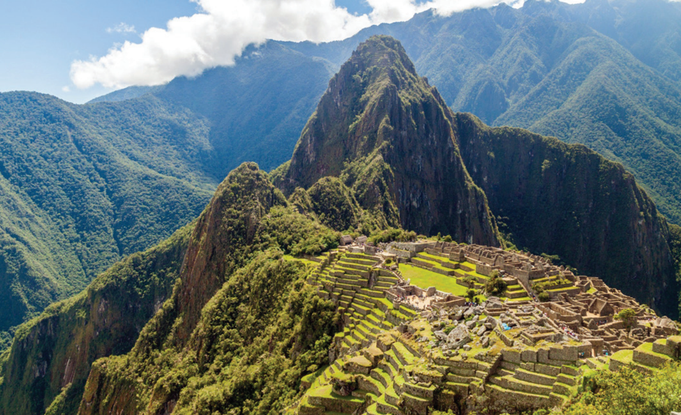
Strand Three: The History of Europe and the Wider World
Chapter Nine: The Age of Exploration and Conquest
Diagram taken from Artefact, 2nd Edition by Eimear Jenkinson and Gregg O'Neill (educate.ie)
@MsDoorley

Slide 47
Checkpoint (pg. 96, Artefact, 2nd Edition)
  Why did Pizarro want to attack the Incas?
  Describe what happened at Cajamarca.
  What did the Incas offer to do for the return of their King?
  Why was Pizarro able to defeat the Incas so easily?
Strand Three: The History of Europe and the Wider World
Chapter Nine: The Age of Exploration and Conquest
@MsDoorley

Slide 48
1400 to 1650
Chapter 9
9.5: THE IMPACT OF COLONISATION
9.5: the impact of colonisation
Strand Three: The History of Europe and the Wider World
@MsDoorley

Slide 49
The Impact of Colonisation
Colonisation is when a country takes over another territory and settles some of its own people there to control it. After Europeans discovered lands in the Americas, Africa and Asia, they conquered these areas and set up colonies in each. This process of colonisation had a huge impact, both on the peoples native to those areas (the colonised) and on the countries who did the colonising (the colonisers). In the century after Columbus arrived in the Americas, about 250,000 people from Spain and Portugal settled in Latin America.
Strand Three: The History of Europe and the Wider World
Chapter Nine: The Age of Exploration and Conquest
@MsDoorley

Slide 50
The Impact of Colonisation on the New World
  The native population was decimated: In 1519, the native population was roughly 25 million. By 1605, this had fallen to about 3 million. Violence and mistreatment was partly to blame. The main cause was disease (90% died because of disease). Europeans introduced epidemic diseases such as smallpox, measles and influenza to the New World. Unlike Europeans, the Americans had no immune system to these diseases.
  The destruction of cultures: The decline of native population led to the loss of old and advanced civilisations. As Spanish and Portuguese became the languages of the ruling classes, native languages and customs were wiped out.
  The spread of Christianity: Priests, especially the Jesuits, set up the Catholic Church in the New World. While the old gods were still worshipped in private, the local populations were severely punished if they were discovered.
  Massive growth in the slave trade: As Catholics could not be taken as slaves and a need to replace natives who died, millions of Africans were transported across the Atlantic. The ‘Atlantic slavery triangle’ developed; ships sailed to African slaving ports and took slaves to the Americas then sailed back to Europe, full of food and precious materials.
Strand Three: The History of Europe and the Wider World
Chapter Nine: The Age of Exploration and Conquest
@MsDoorley

Slide 51
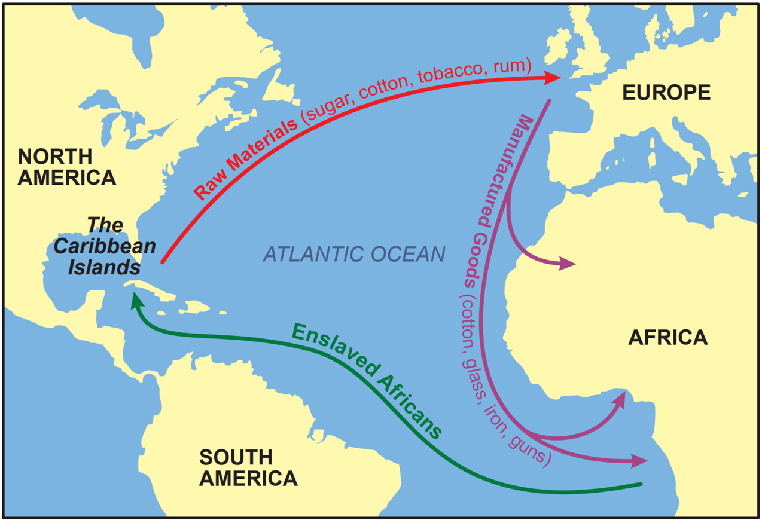
Strand Three: The History of Europe and the Wider World
Chapter Nine: The Age of Exploration and Conquest
Diagram taken from Artefact, 2nd Edition by Eimear Jenkinson and Gregg O'Neill (educate.ie)
@MsDoorley

Slide 52
The Impact of Colonisation on European Empire
1. Other European states saw the wealth and power that Spain was gaining from its conquests in South American and decided to make empires of their own.
  Portugal explored and settled the east coast of South America, modern-day Brazil. Portuguese is Brazil’s first language and Uruguay’s second; the rest of South America speak Spanish.
  England (Britain from 1707) set up colonies in eastern North America. Britain would later expand its empire to cover Ireland, India, large sections of Africa, Australia and New Zealand. Britain would also become the strongest and largest empire in the world, colonising almost 25% of the world’s population.
  France conquered parts of North America (mainly inland and Canada) as well as parts of Africa and Asia.
  The Netherlands, founded in 1579, conquered the Spice Islands (modern-day Indonesia).
2. Countries were scrambling for territory which led to conflicts;
  Spain and Portugal almost went to war over South America until Pope Alexander VI forced them to sign the Treaty of Tordesillas in 1494.
  Other conflicts included; Britain and Spain (1585-1604), France and Spain (1595-1598), and Britain and France (1756-1763).
Strand Three: The History of Europe and the Wider World
Chapter Nine: The Age of Exploration and Conquest
@MsDoorley

Slide 53
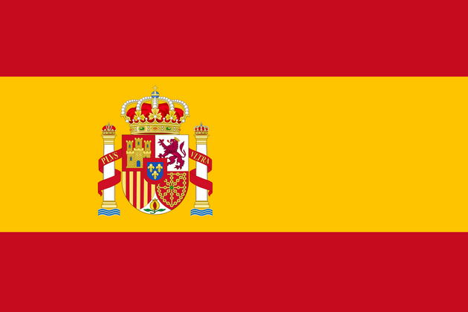
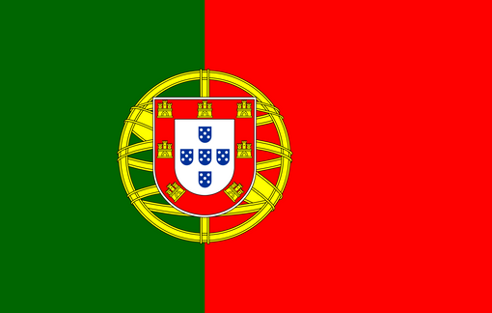
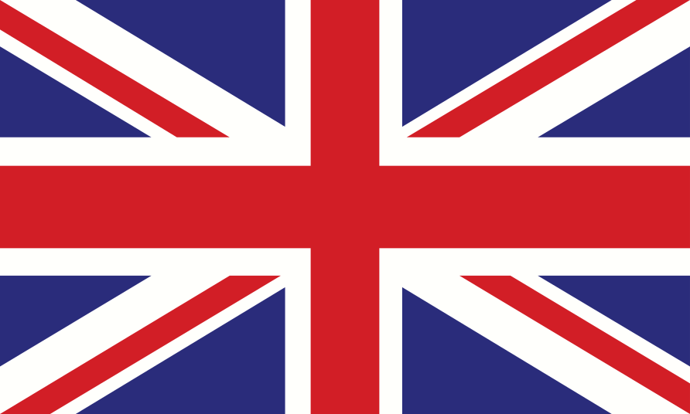

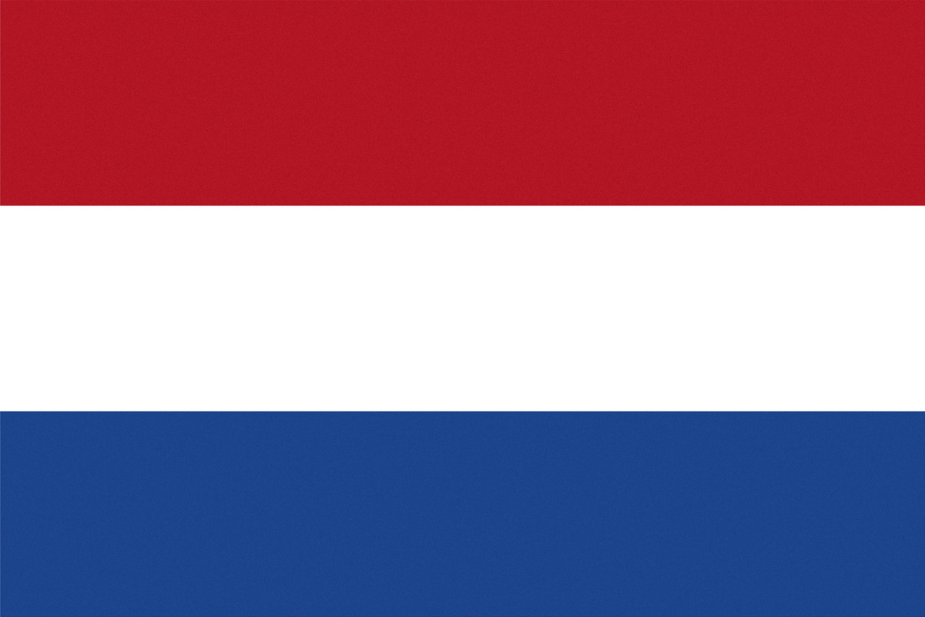
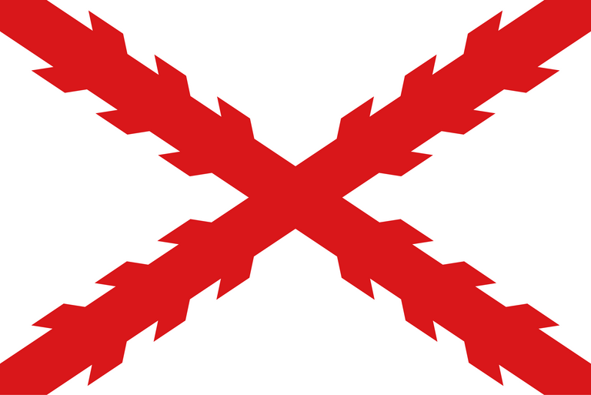
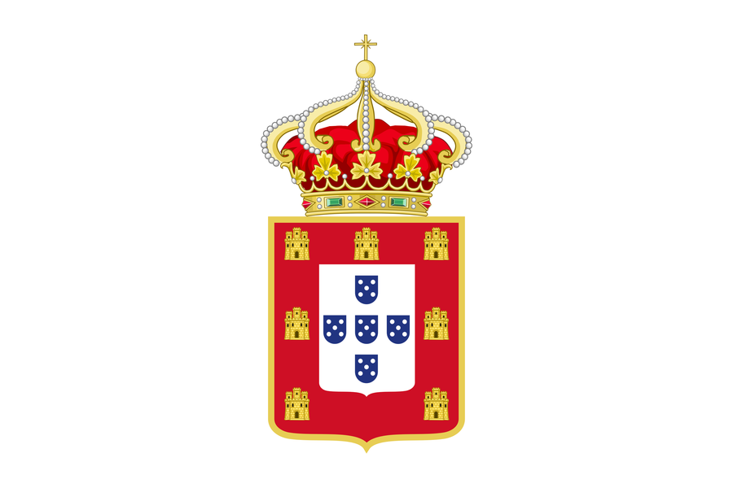
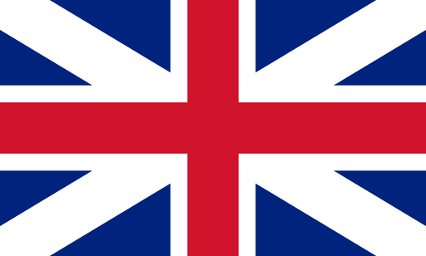


The Impact of Colonisation on European Empire
3. Huge deposits of gold and silver from the Andes were shipped back to Spain, making it the most powerful country in Europe throughout the 1500s and 1600s. Italy’s power declined as the focus for trade shifted away from its city states and to the Atlantic coast.
4. The ‘Columbian exchange’ was the exchange of foods and animals between Europe and the Americas, changing the to continents forever. Horses, cattle, sheep, new farming methods and new technologies were introduced to the Americas. Potatoes, chillies, avocado, cocoa (chocolate), coffee, tomatoes and tobacco were introduced to Europe.
Strand Three: The History of Europe and the Wider World
Chapter Nine: The Age of Exploration and Conquest
@MsDoorley

Slide 54

Strand Three: The History of Europe and the Wider World
Chapter Nine: The Age of Exploration and Conquest
Diagram taken from Artefact, 2nd Edition by Eimear Jenkinson and Gregg O'Neill (educate.ie)
@MsDoorley

Slide 55
Checkpoint (pg. 99, Artefact, 2nd Edition)
  What is colonisation?
  Give an example of a coloniser and a country they colonised.
  How were the people of South America affected by European diseases?
  What was the ‘Atlantic slavery triangle’?
  Name two European countries that established empires and detail where.
  Why did colonisation lead to conflict between European powers? Give an example.
  What was the ‘Columbian exchange’?
Strand Three: The History of Europe and the Wider World
Chapter Nine: The Age of Exploration and Conquest
@MsDoorley

Slide 56
1450 to 1650
Chapter 9
4.6: SUMMARY
4.6: summary
Strand Three: The History of Europe and the Wider World
@MsDoorley

Slide 57
In this chapter, we have learned that...
Causes of the voyages of exploration
  The influence of the Renaissance
  Marco Polo’s stories of the wonders of the East
  A need for new trade routes
  Competing European states wanting to expand, build empires and spread Christianity.
New technology
  New portolan maps
  New equipment: the astrolabe, quadrant, compass, log and line
  New ships: caravels with lateen sails and new carvel-built hulls.
  These innovations allowed Portuguese explorers (like da Gama) to sail around Africa and Spanish explorers (like Columbus) to sail across the Atlantic.
Strand Three: The History of Europe and the Wider World
Chapter Nine: The Age of Exploration and Conquest
@MsDoorley

Slide 58
In this chapter, we have learned that...
Impact of European conquest on the New World
  South America’s major native civilisations fell to Spanish conquistadores: the Aztecs to Cortés and the Incas to Pizarro.
  The native population was decimated, both by violence and by European diseases.
  Native culture was destroyed.
  Christianity spread in the New World as the native people converted in large numbers.
  The slave trade between Africa, the Americas and Europe became established.
  New animals (horses, cattle, sheep), farming methods and technology reached the New World.
Impact of European conquest on Europe
  Empires were founded by Spain, Portugal, France, Britain and the Netherlands.
  Conflicts became more frequent as those empires fought over territory and wealth.
  Many new goods from the Americas reached Europe (for example, potatoes, tomatoes and tobacco)
Strand Three: The History of Europe and the Wider World
Chapter Nine: The Age of Exploration and Conquest
@MsDoorley

Slide 59
Reflecting on... the Renaissance
The European Age of Exploration and Conquest was an incredibly important period in world history. Until quite recently, Western historians treated it as the story of heroic explores and the dangerous voyages they made. However, our understanding has since shifted to see the terrible and lasting effects that European colonisation had upon other peoples of the world.
Strand Three: The History of Europe and the Wider World
Chapter Nine: The Age of Exploration and Conquest
@MsDoorley

Slide 60
Examination Questions
2022 SEC Q3
Strand Three: The History of Europe and the Wider World
Chapter Nine: The Age of Exploration and Conquest
@MsDoorley

Slide 61
Project
Guidelines:
  Length: The depth of your project should reflect about 2-3 weeks of work.
  Sources: Use at least three different sources for your research. These can be books, scholarly articles, or reputable online resources.
  Citations: All information and images that are not your own should be properly cited.
  Mediums: You may choose to present your project in one of the following ways:
    Poster: Your poster should be informative and visually engaging.
    Minecraft or Lego Model: If choosing this option, please also include a brief report explaining your model.
    Painting/Drawing: Your artwork should be accompanied by a description.
    Recycled Materials: Create your model using recycled materials and provide an explanation of your creative process.
Assessment:
Your projects will be assessed based on:
  Research and Content
  Creativity and Presentation
  Understanding of Context
  Adherence to Guidelines
Strand Three: The History of Europe and the Wider World
Chapter Nine: The Age of Exploration and Conquest
@MsDoorley

Slide 62
Project
Historical Sites
Historical Figures
Belem Tower, Lisbon, Portugal
Archive of the Indies, Seville, Spain
Table Mountain, Cape of Good Hope, South Africa
Mayflower Steps, Plymouth, England
Castillo San Felipe del Morro, San Juan, Puerto Rico
Henry the Navigator
Ferdinand Magellan
Bartolomé de Las Casas
John Cabot
Samuel de Champlain
Vasco da Gama
Hernan Cortés
Giovanni de Verrazano
Francis Drake
Henry Hudson
Christopher Columbus
Francisco Pizarro
Walter Raleigh
Jacques Cartier
Queen Isabella
Strand Three: The History of Europe and the Wider World
Chapter Nine: The Age of Exploration and Conquest
@MsDoorley

